Slide 1
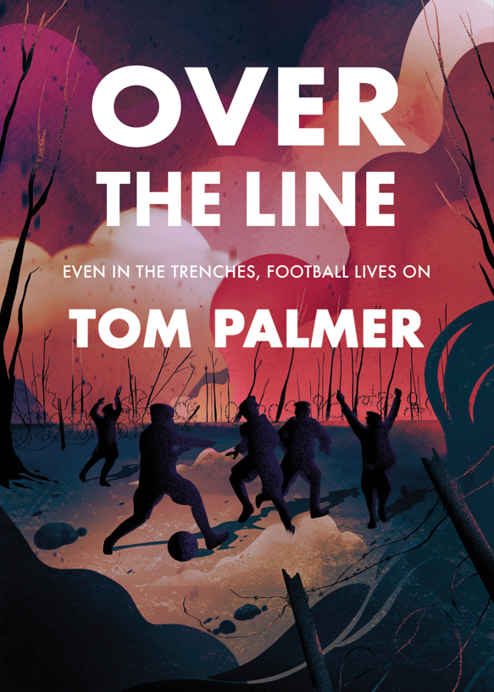
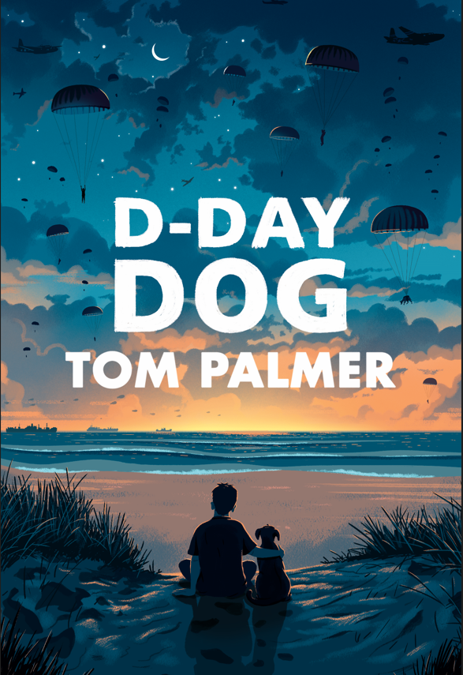
War. What would you do?

Slide 2
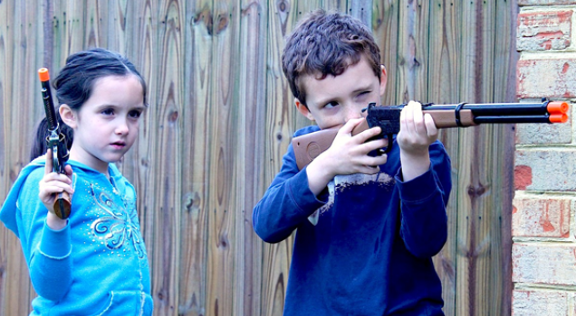
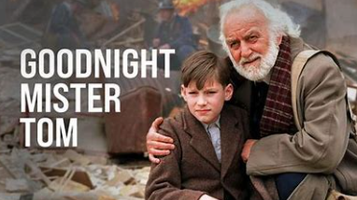
Is
war
entertaining?

Slide 3
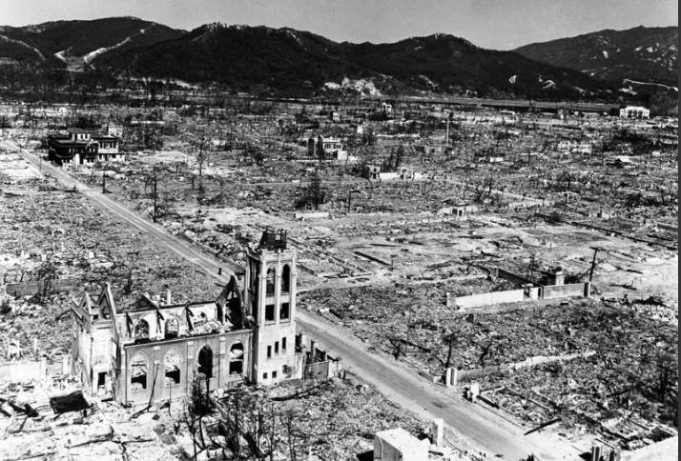
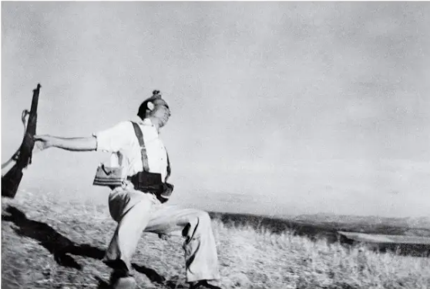
Or do you think war is terrible?

Slide 4
War. What would you do?

Slide 5
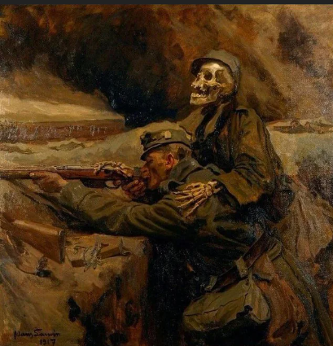
If your brother was killed at war, would you sign up to take revenge on the enemy that killed him?

Slide 6
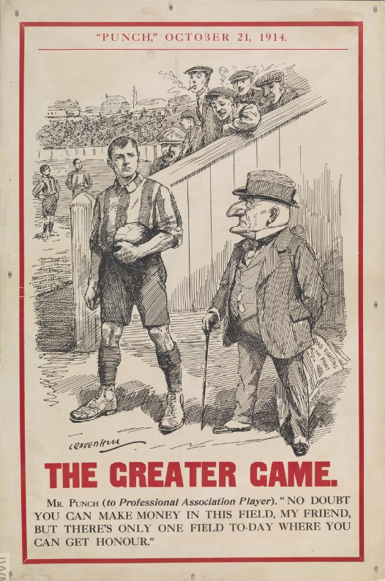
Would you give up being a footballer to fight a war for your country?

Slide 7
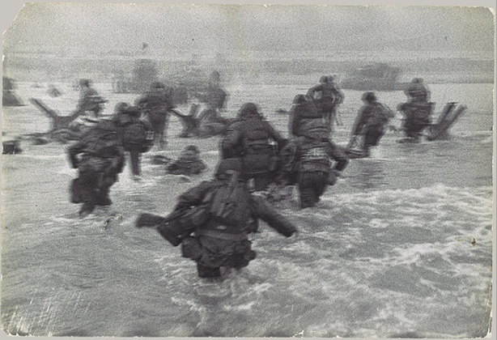
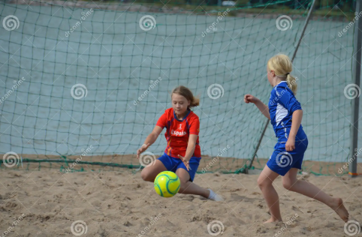
Would you play football on Omaha Beach?

Slide 8
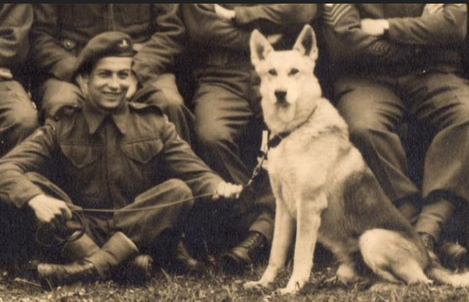
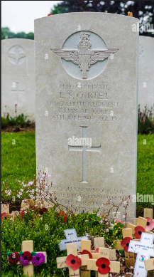
Should animals be part of war?

Slide 9
If you desert from the military, does that make you a coward?

Slide 10
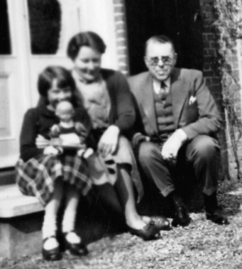
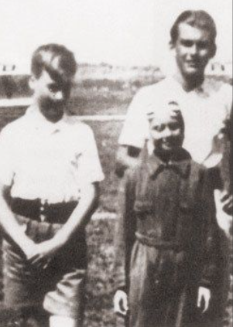
Would you join the resistance if your country was invaded, your family murdered and enslaved?

Slide 11
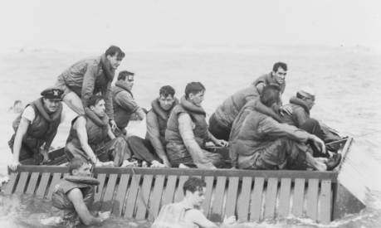
If you were with a fellow sailor when he died, how would you tell their parents about it?

Slide 12
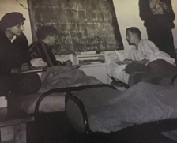
If you had suffered the worst events in history, would you be able to get up in the morning?

Slide 13
Is war ever a good thing?

