Slide 1
Cumbria World War II Quiz

Slide 2
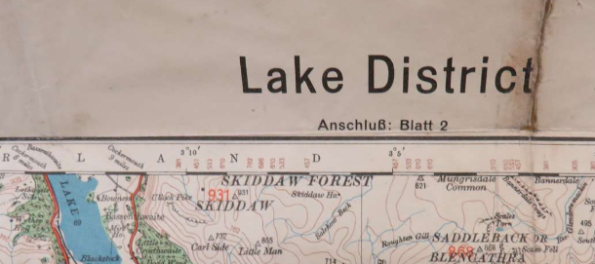
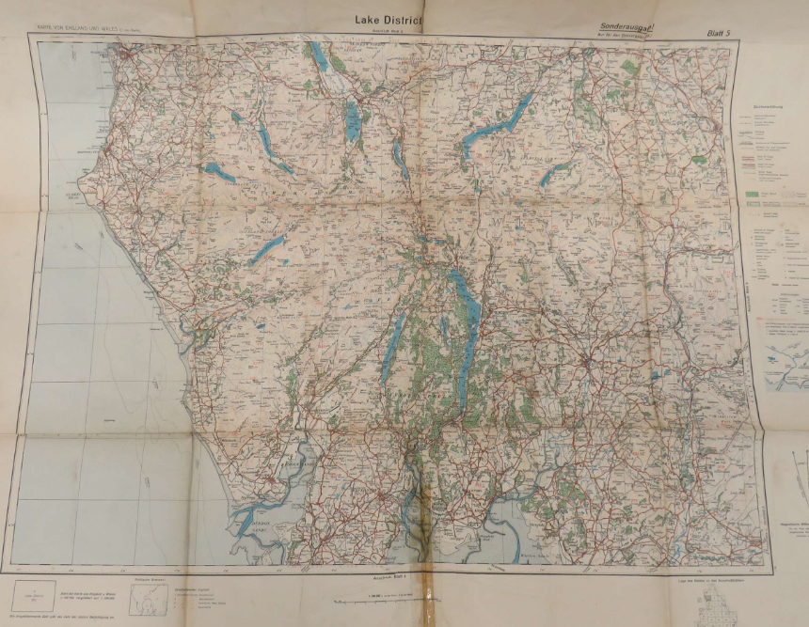
Question 1
How did the Nazis plan to invade the area we now call Cumbria?
A landing craft from the sea around Workington
B tank formations up the M6
C airborne paratroopers and gliders landing on tarns and fells

Slide 3
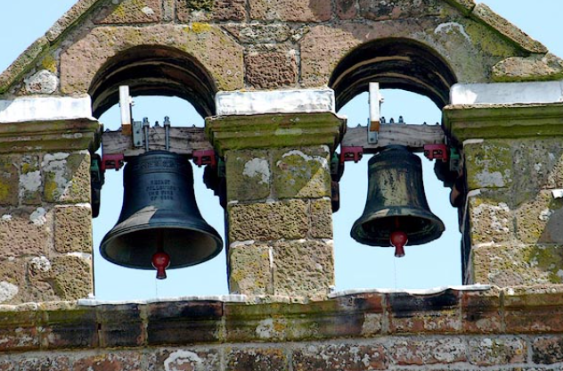
Question 2
During WW2, the church bells could only ring in churches in Cumbria for one reason.
What was it?
A victory
B Nazi invasion
C funerals

Slide 4
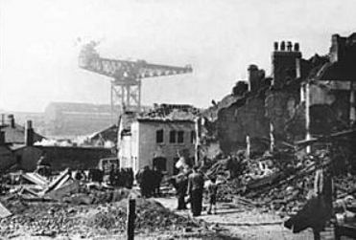
Question 3
Which Cumbrian town or city was
bombed the most frequently during the Second World War?
A Carlisle
B Barrow
C Whitehaven

Slide 5
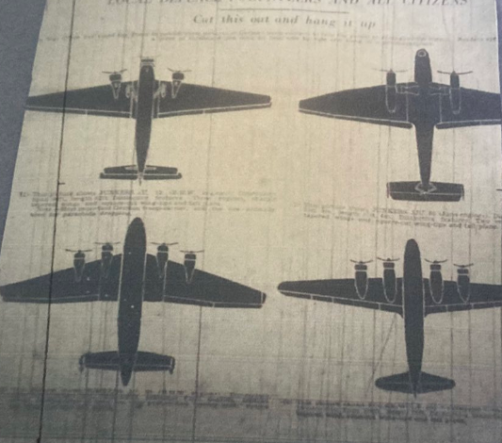
Question 4
This is a silhouette picture of planes from the Westmorland Gazette in 1940.
If you saw them what should you do?
A run for cover
B wave hello
C watch for paratroopers

Slide 6
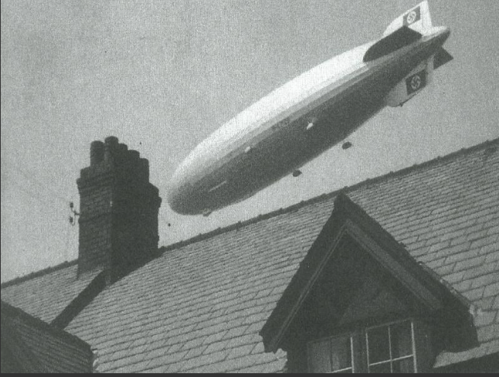
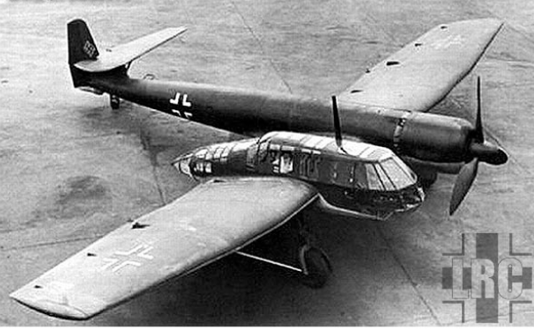
Question 5
How did the Nazis know where to bomb in Barrow?
A early satellite technology
B spy balloons on their way to New York
C spy planes in the clouds

Slide 7
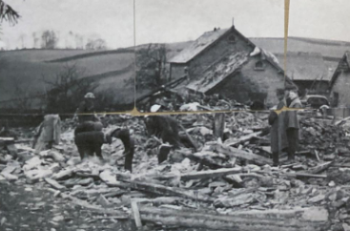
Question 6
For what reason was this farmhouse near Kendal
- known as “The Cooper House” - bombed, killing 11 people?
A Churchill was staying there
B It was a secret listening post
C The Nazis bombed it by accident

Slide 8
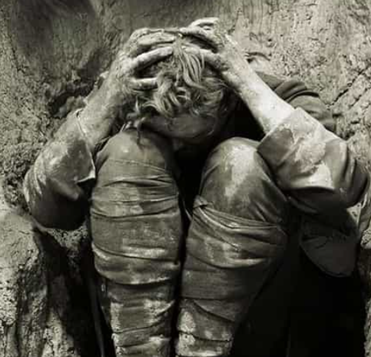
Question 7
Why did some soldiers hide in the hills during the war?
A to avoid being near civilians and giving away military secrets
B because they were suffering from PTSD and could not cope with going back to war
C because they were cowards

Slide 9
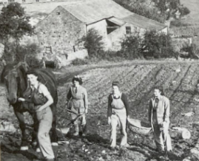
Question 8
What were the women called who came to Cumbria to work on the farms and help feed the country?
A City Slickers
B Land Girls
C Munitionettes

Slide 10
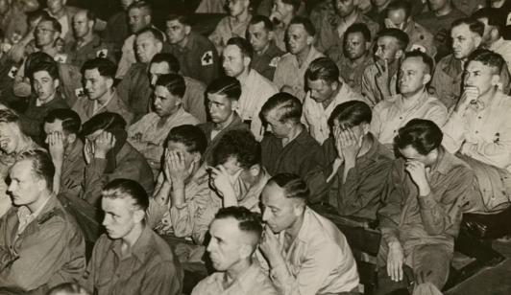
Question 9
Large numbers of people came to the Cumbria area during the war.
Which group are pictured here?
A refugees
B American GIs on leave
C German POWs

Slide 11
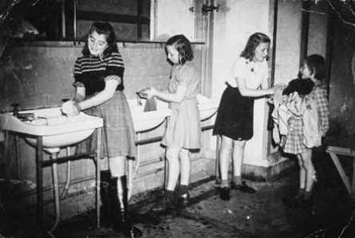
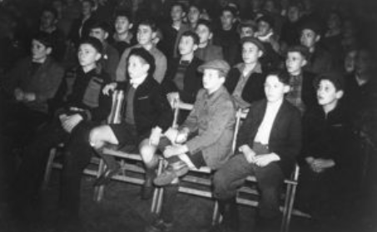
Question 10
In August 1945, 300 children arrived to live where the Lakes School, Ambleside is now.
Who were they?
A volunteers from USA to help us recover from the war
B child Holocaust survivors from the liberated concentration camps
C the first German tourists, welcomed to England to help us all make friends again after the war

Slide 12
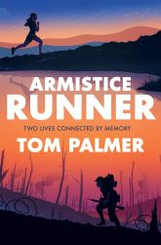
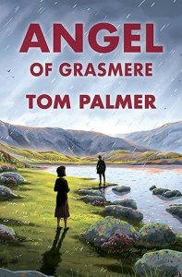
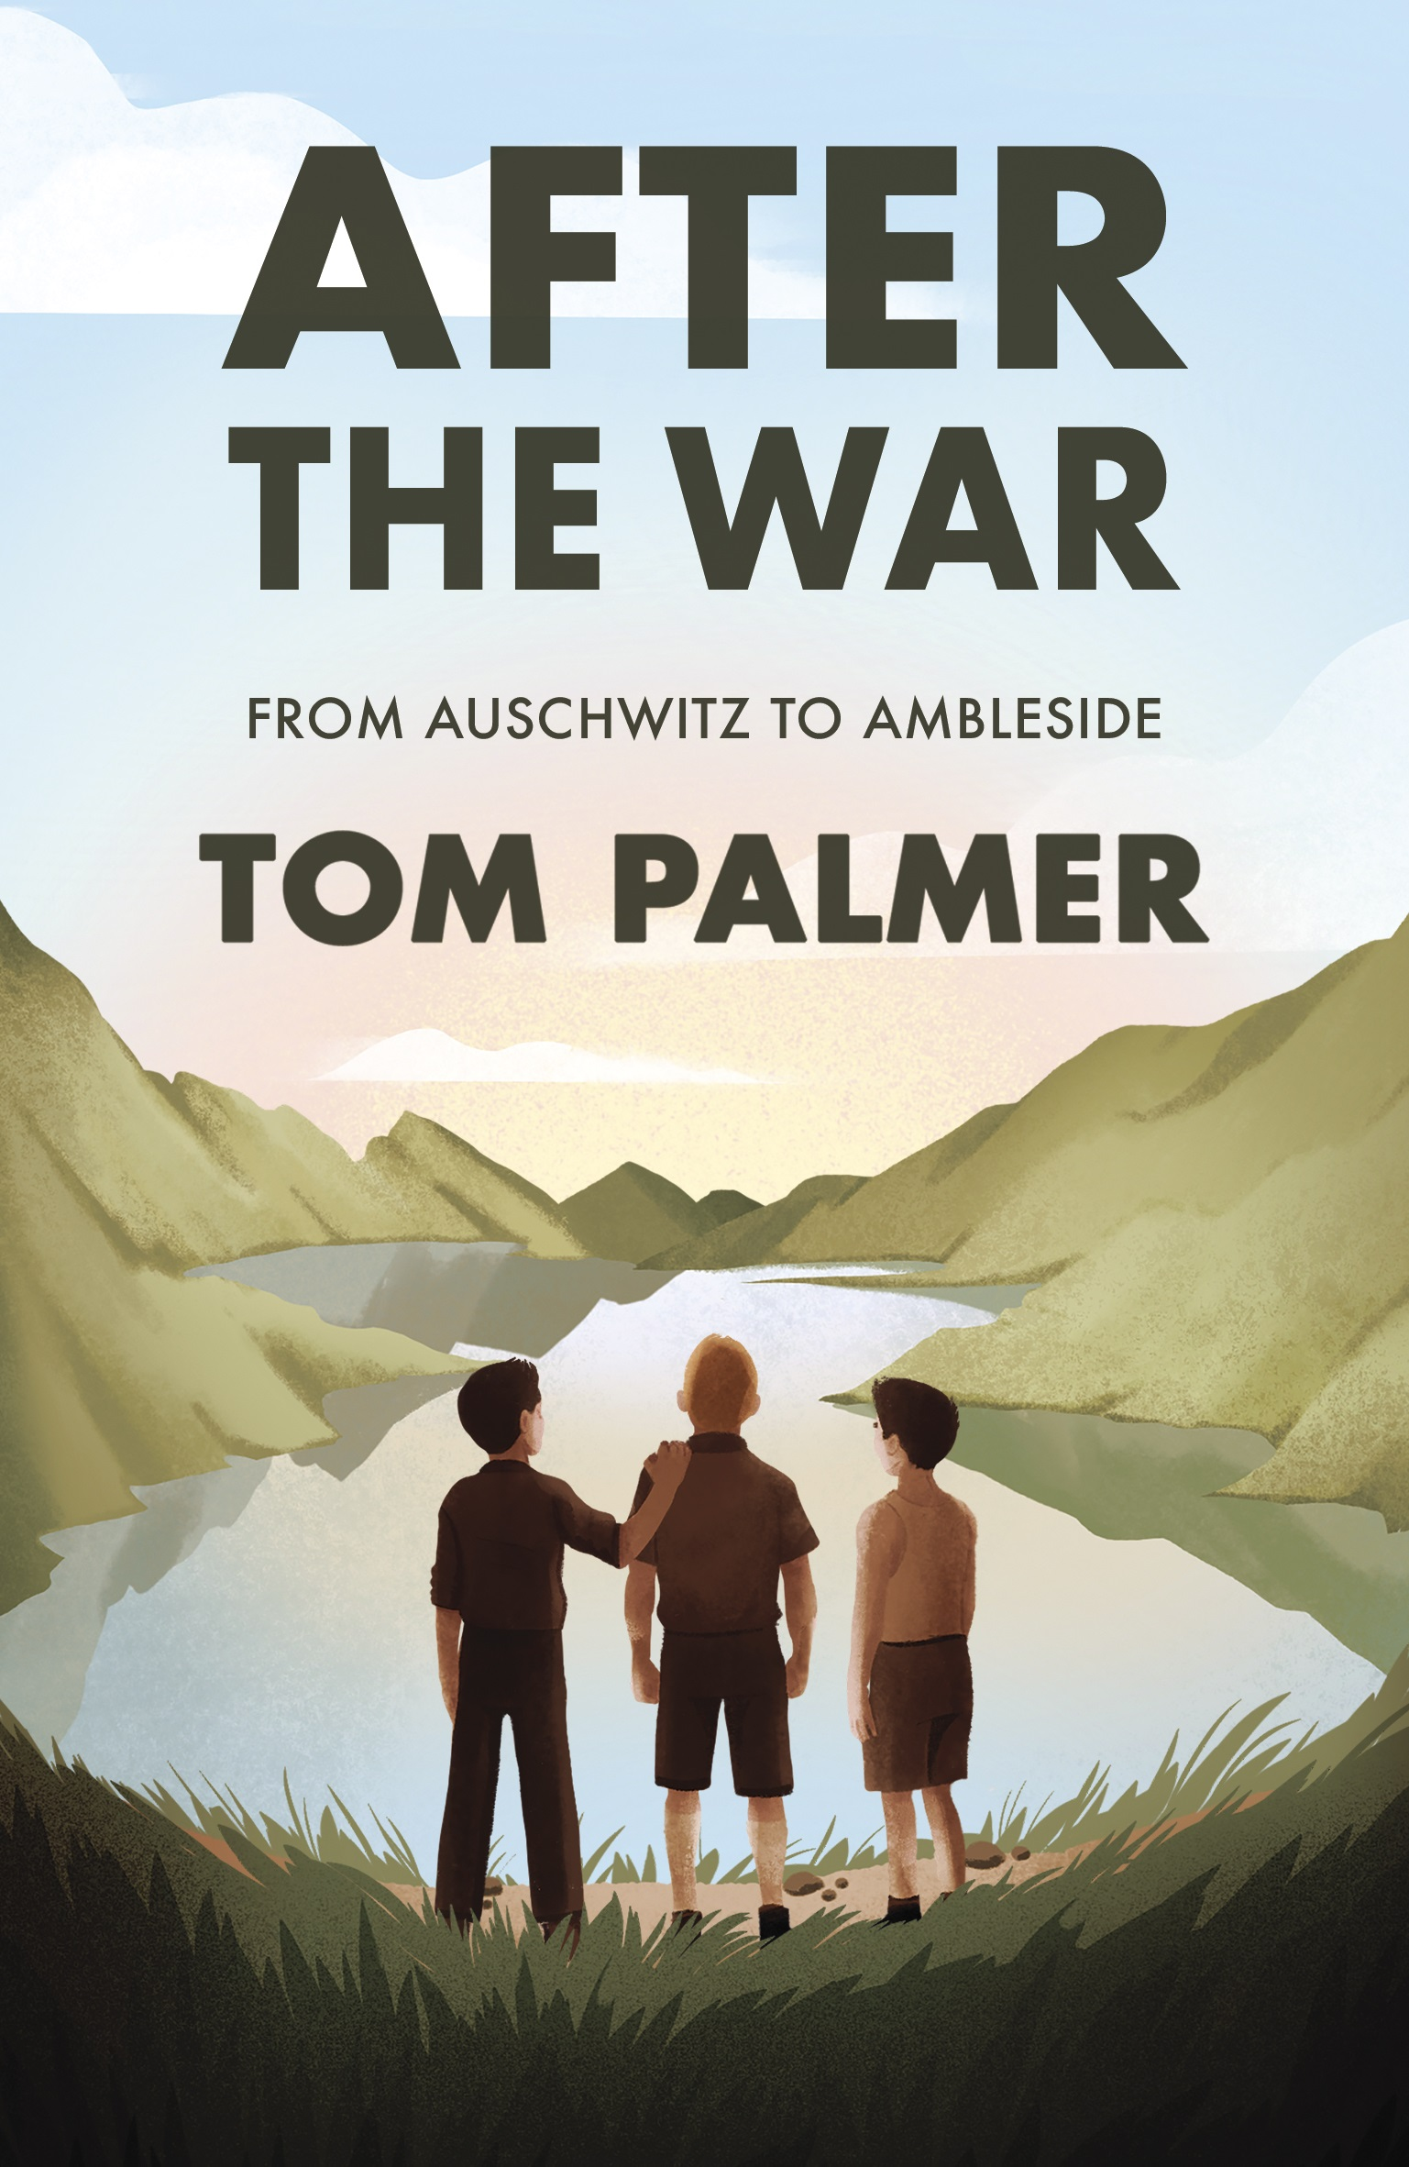
Tom’s Three Children’s Books set in Cumbria
Armistice Runner
Lily is a 13 year old fell runner, inspired by her Lakeland great-great grandfather’s First World War trench-running diary. tompalmer.co.uk/armistice-runner/
Angel of Grasmere : from Dunkirk to the Fells
Tarn grapples with the loss of her brother at Dunkirk as her village faces the threat of Nazi invasion of Britain in this gripping wartime tale tompalmer.co.uk/angel-of-grasmere/
After the War : from Auschwitz to Ambleside
The true story of the 300 child concentration camp child survivors who at the end of the Second World War came to the Lake District (known as the Windermere Boys). tompalmer.co.uk/after-the-war/

