Slide 1
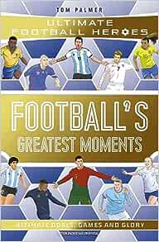
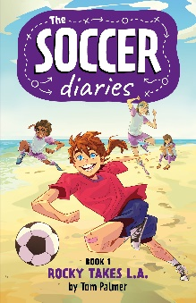
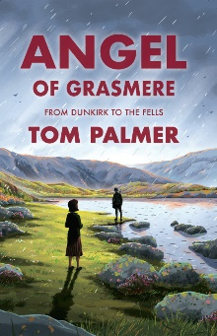

Slide 2
About me
I wasn’t keen on reading when I was young.
My mum was worried about me because I didn’t do very well at school.
She encouraged me to read about football in newspapers, magazines and books.
Gradually I came to love books.

Slide 3
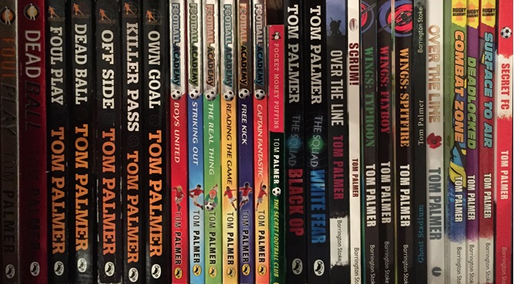
About my books
I have written 60 books for children
My books have been translated into 12 languages
I have sold over 1,000,000 books
I am not a millionaire! I live in a terraced house and drive a second-hand Honda Civic.

Slide 4
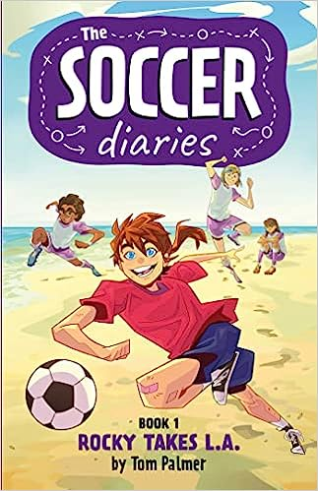
What are you writing now?
At the moment I am writing about Rocky and her brother Roy of the Rovers.
Rocky is one of my favourite characters to write as I never know what she is going to do next.
And my next book to be published in 2024 is Angel of Grasmere – my third children’s book et in the Lake District.

Slide 5
Angel of Grasmere out May 2024
NEW
Tarn Fothergill is struggling to come to terms with the loss of her beloved brother in the chaos of the British retreat at Dunkirk.
She and her friends explore the fells on the look out for the Nazi invasion of their Lakeland homes
In the midst of the darkness the villagers are receiving anonymous acts of kindness – could there really be an Angel of Grasmere?

Slide 6
How long does it take to write a book?
Short books like Football Academy take a month. Longer Foul Play books take four to five months. Historical books take six or more months to research and write.

Slide 7
Football Academy series
My Football Academy books are about a Premier League under-twelve side – about what it’s like to play the game at the top.
Ryan is the team captain – so why does he bully his team mates?
Yunis is the star player – so why does his dad want him to give up football?
James is the son of an England international – so why does he start making terrible mistakes?

Slide 8
Often from newspapers. Football is full of crime. When a story grips me, I know it’s one I can use in a book.
Where do you get your ideas from?

Slide 9
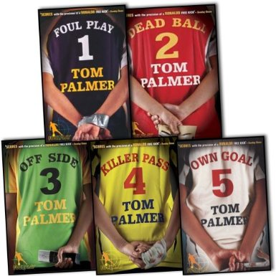
Foul Play series
Fourteen-year-old Danny Harte and his friend
Charlotte solve football crimes. Together, they …
take on a dodgy football chairman in Foul Play
face a Russian billionaire in Dead Ball
defeat a corrupt footballer trafficking agent in Off Side
tackle a burglar of footballers’ houses in Killer Pass
uncover a worldwide football scam in Italy in Own Goal

Slide 10
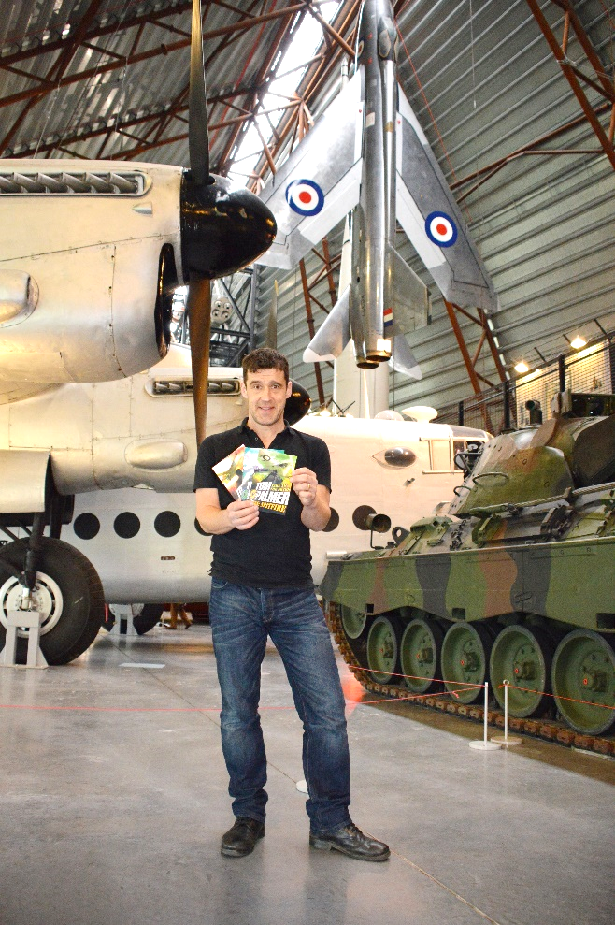
I have also written about … cats, cricket, dementia, dogs, dyslexia, environment, ghosts, Ghana, fair trade, Italy, the Holocaust, having a parent with a disability, the First and Second World Wars, having a parent in prison, the RAF, Russia, the Royal Navy, rugby, soldiers, racism, running and young carers
Are all your books about football?

Slide 11
Rugby Academy series
Rugby Academy was inspired by children of serving RAF personnel, and I used their input to get life in a forces family right.
Football-mad Woody finds himself stuck in a rugby-obsessed British boarding school, as his dad is being deployed on dangerous military service overseas.

Slide 12
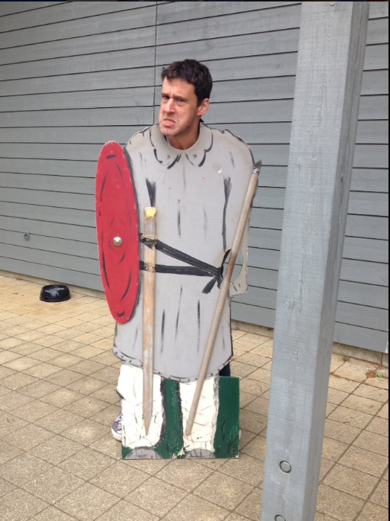
Why do you like to write about history?
I am really interested in how people lived their lives a long time ago.
There are lots of parallels with our life today.
I like reading stories and watching films set in historical times.
I enjoy visiting historic castles and archaeological sites and they give me more ideas for stories.

Slide 13
Defenders
In my KS2 history series, the Defenders trilogy, Seth and Nadiya specialise in solving ghostly hauntings at football venues, which take them to settings including:
Anglo-Saxon village, Yorkshire
Roman Amphitheatre, City of London
Iron Age Celtic hill fort, Cornwall
The past is closer than Nadiya and Seth think …

Slide 14
Why do you write about war?
Since I was young I have been drawn to war stories. Like most people my age, when I was a kid, Sunday afternoons involved watching WW2 war films, when the soldiers and the battles they fought in were always heroic.
I also grew up trying to make sense of the troubles in Northern Ireland on the TV news. And wars in the Falkland Islands, former Yugoslavia, Iraq, Libya and now Syria.
I’m still confused about war. But I know that I hate it.

Slide 15
D-Day Dog
Jack can't wait for the school trip to the D-Day landing beaches - his chance to learn about his war heroes - brave men like his own reserve soldier dad.
But when his dad is called up to action Jack questions everything he believes in.
Finding comfort only in his loyal dog, Finn, Jack is drawn to the true story of one particular D-Day paratrooper.
On 6 June 1944, Emile Corteil parachuted into France with his dog, Glen - and Jack is determined to discover their fate ...

Slide 16
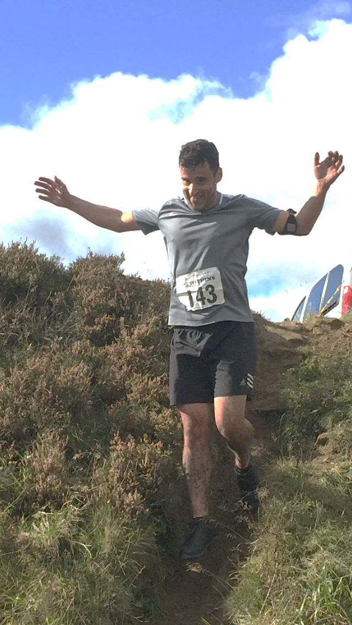
Why have you written about running?
Armistice Runner is based very loosely on our family’s love of cross country and fell running and the champion fell runner of 100 years ago, Ernest Dalzell.
My daughter is a fell and cross-country runner (as am I) and I wanted the story to come from the point of view of a girl like her and the other keen children who enjoy running cross country and on the fells.

Slide 17
Armistice Runner
Armistice Runner is about a thirteen-year-old cross country/fell runner called Lily.
She discovers the diaries of her great, great grandfather, who was a champion fell runner and a trench runner during the last weeks of the First World War.

Slide 18
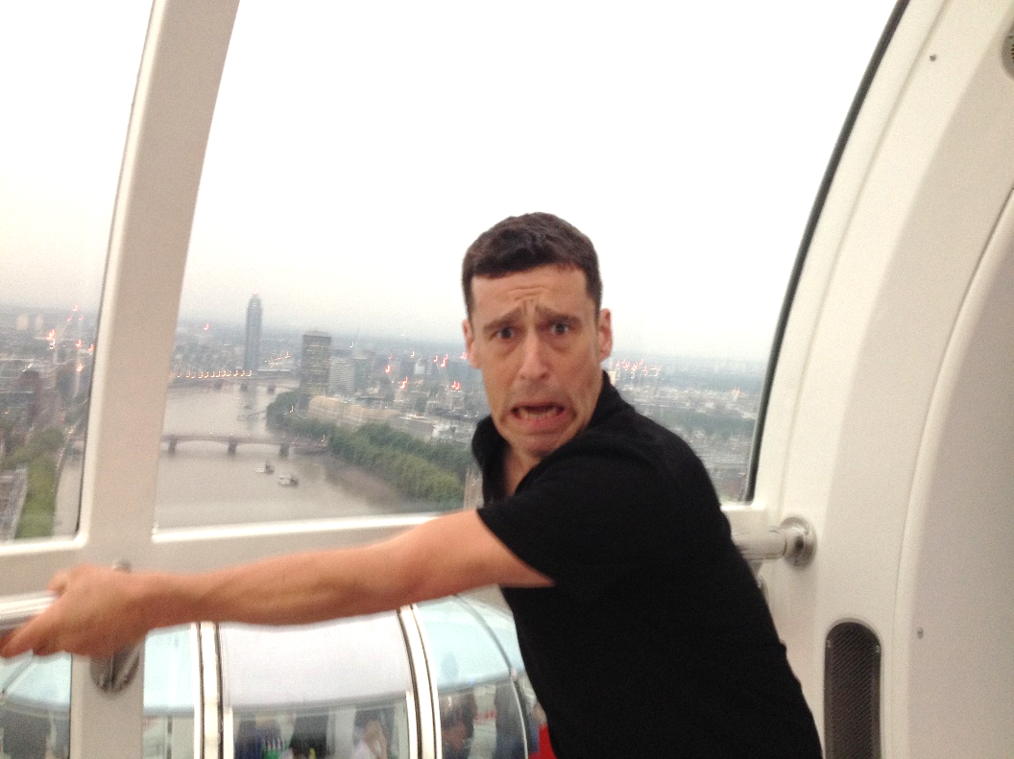
Have you any tips on writing?
Write about something you enjoy and are interested in
Read lots of other books to help improve your writing
Share your writing with others and ask them what bits they did and didn’t like
Talk to people about their lives
Try interesting new things
Don’t be scared and don’t give up!

Slide 19
Arctic Star
Winter 1943. Teenagers Frank, Joseph and Stephen are Royal Navy recruits on their first mission at sea during the Second World War, on HMS Belfast part of an Arctic convoy sailing to Russia to deliver supplies to the Soviets.
Faced with terrifying enemy attacks from both air and sea, as well as life-threatening cold, gales and pack ice, will all three boys make it home again?

Slide 20
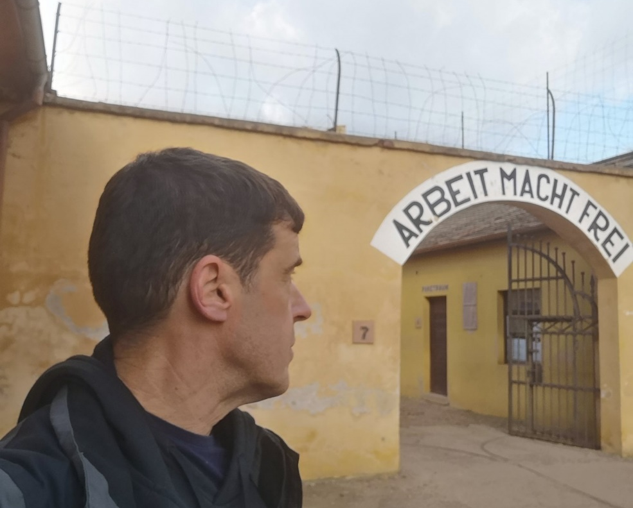
How do you write about difficult true stories?
Stick absolutely to the facts
Talk to those who have first hand experiences
Visit the places you are describing
Read documents
Share your writing with experts
Test your drafts on pupils to make sure they understand

Slide 21
After the War – from Auschwitz to Ambleside
Summer 1945. The Second World War is finally over and Yossi, Leo and Mordecai are among three hundred children who arrive in the English Lake District.
Having survived the horrors of the Nazi concentration camps, they’ve finally reached a place of safety and peace, where they can hopefully begin to recover.
Will life by the beautiful Lake Windermere be enough to bring hope back into all their lives?

Slide 22
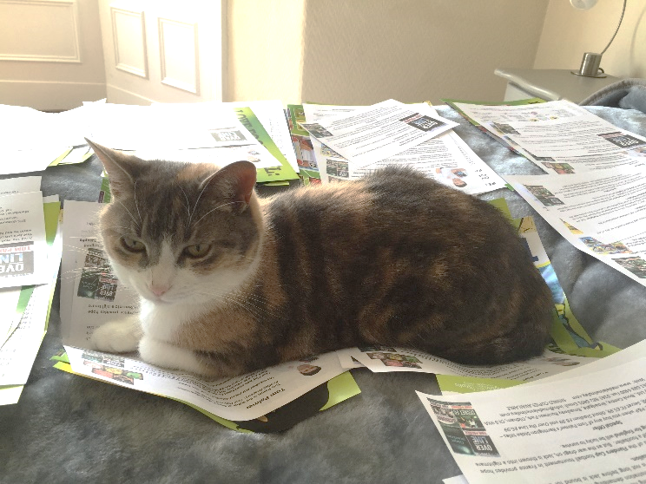
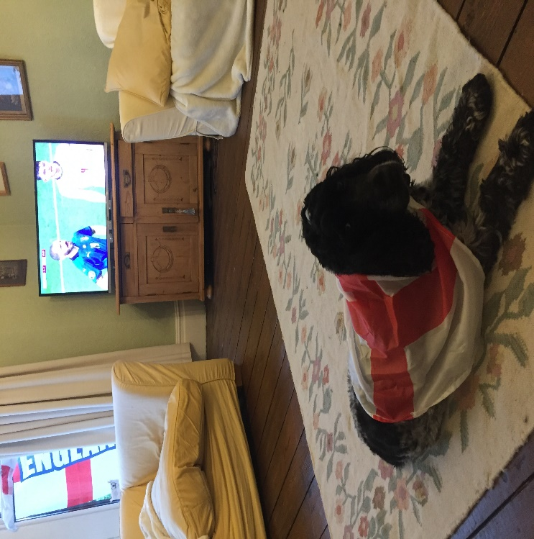
My family help me develop stories My editor checks the story And my pets help in lots of ways…
Does anyone help you write your books?

Slide 23
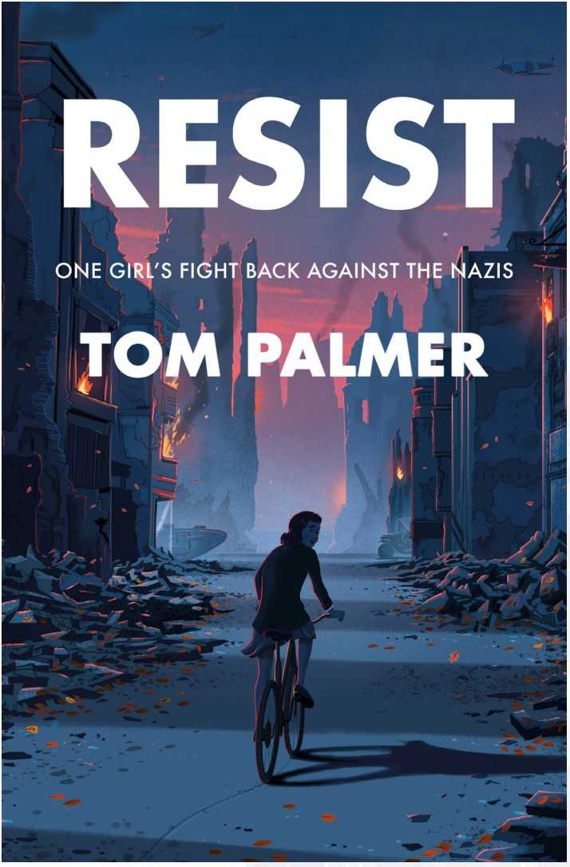
Resist
Shines a light on the incredible Dutch resistance, in a Second World War story inspired by the childhood of Hollywood legend Audrey Hepburn.
Life in Nazi-occupied Netherlands is fraught with little to eat and the constant threat of arrest and enslavement.
Edda is determined to help the Dutch people fight back. But what can a teenage girl do and how much risk is she willing to take?

Slide 24
About my favourite things
Favourite team: Leeds United
Favourite stadium visited: Elland Road, Leeds (but also Bernabeu, Spain and Hearts of Oak, Ghana)
Favourite player (ever): Lucas Radebe, Leeds
Favourite football magazine: World Soccer
Favourite football book: Keeper by Mal Peet
Food: Fair Trade chocolate
Country: Norway
Drink: Yorkshire tea

Slide 25
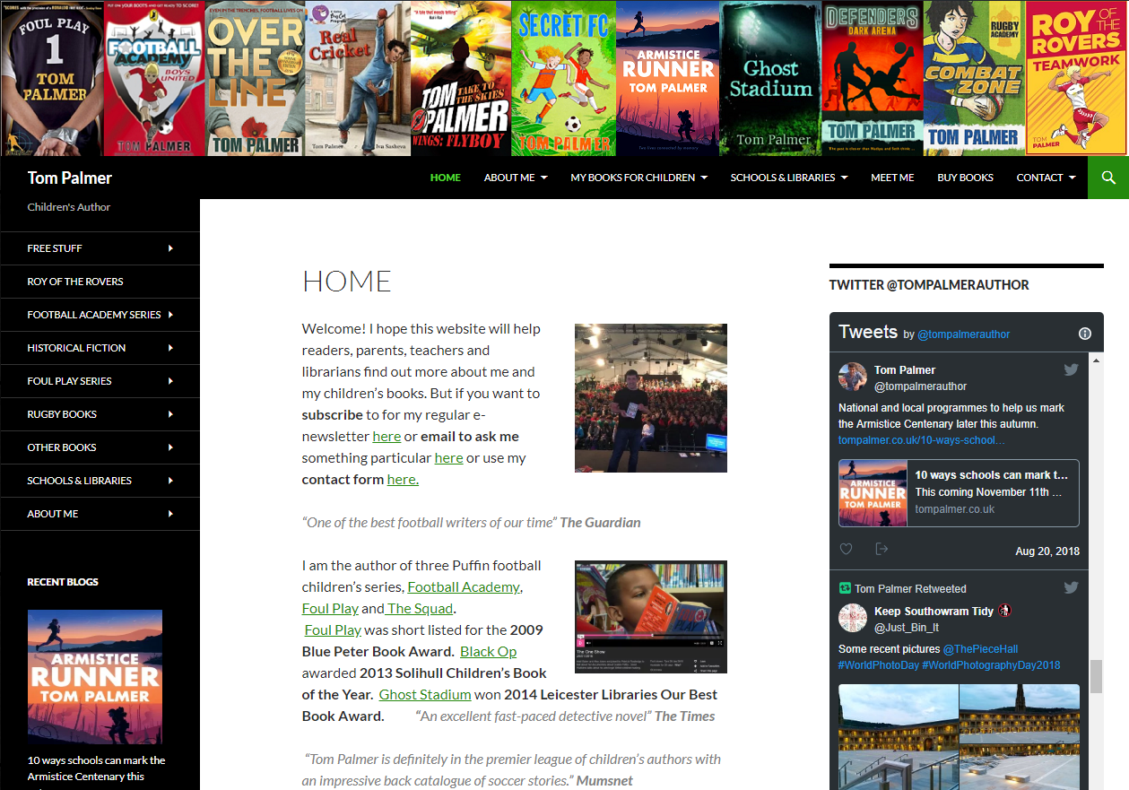
Visit www.tompalmer.co.uk
Read free chapters
Watch videos of Tom reading from his books or on his research trips
Try Reading Quizzes
Listen to podcasts
Find out more about the characters in my books

