Slide 1
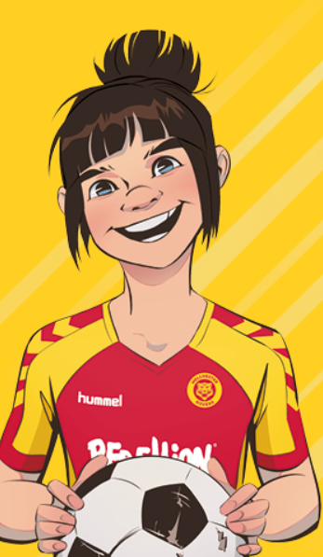
WORLD CUP READING GAME
Can you answer Rocky’s 10 questions about
different ways you can read about the 2023 World Cup?

Slide 2
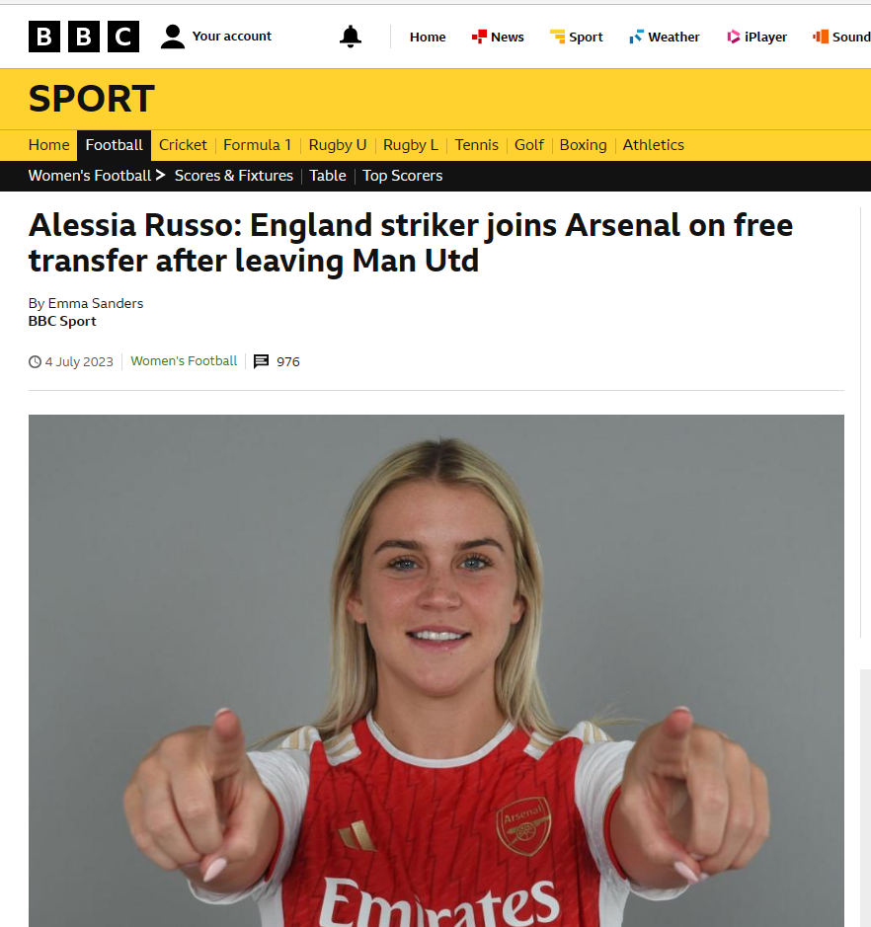
QUESTION ONE
Which team did Russo join after leaving Man Utd before joining up with England for the World Cup?

Slide 3
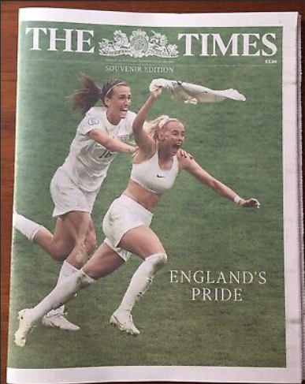
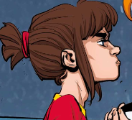
QUESTION TWO
Who is the player on the cover of the Times newspaper, celebrating scoring the EURO ‘22 winnng goal?

Slide 4
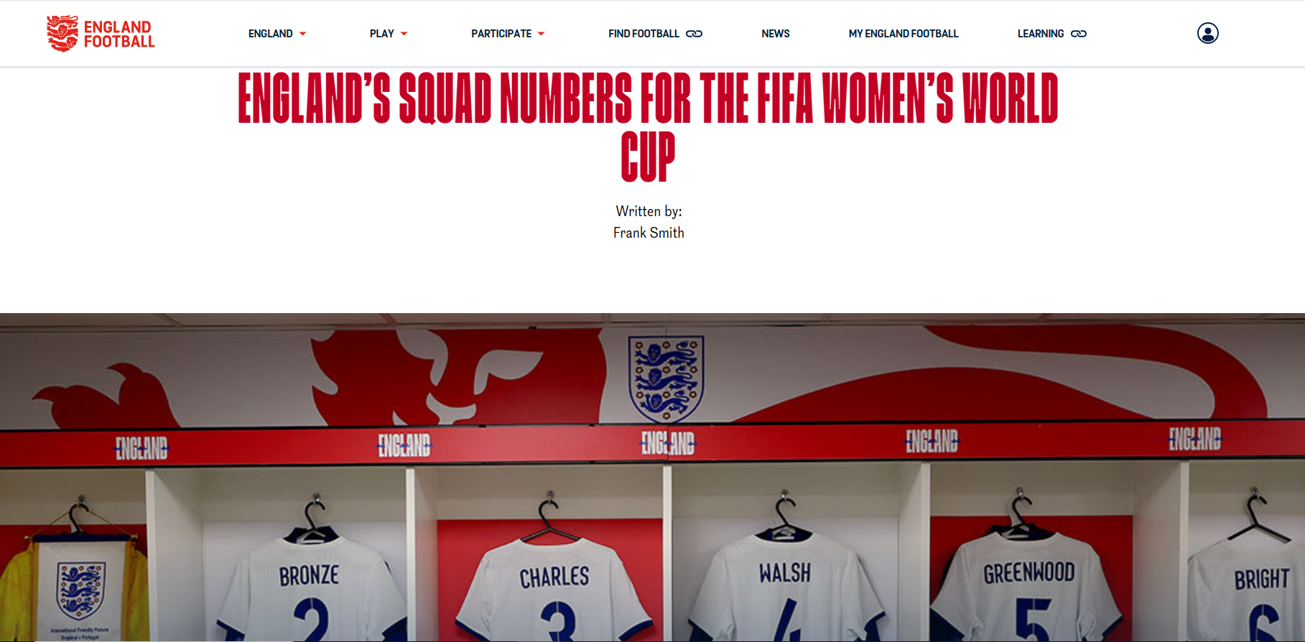
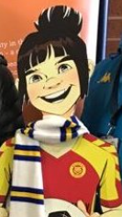
QUESTION THREE
The England website has announced the squad numbers for the World Cup. What number will Mary Earps be wearing?

Slide 5
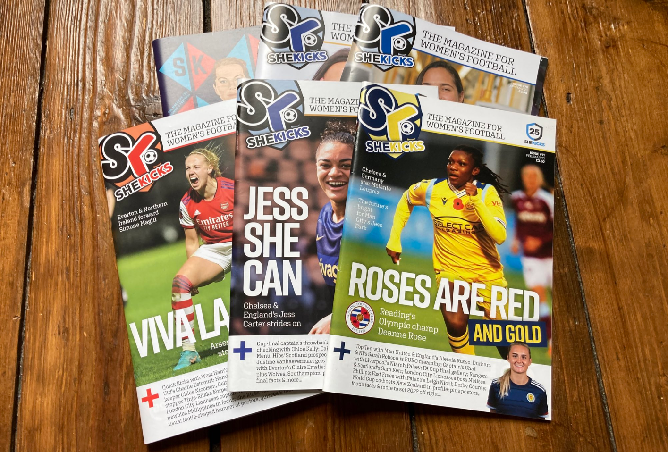
QUESTION FOUR
What is the surname of the player called Jess on the middle issue of She Kicks magazine?

Slide 6
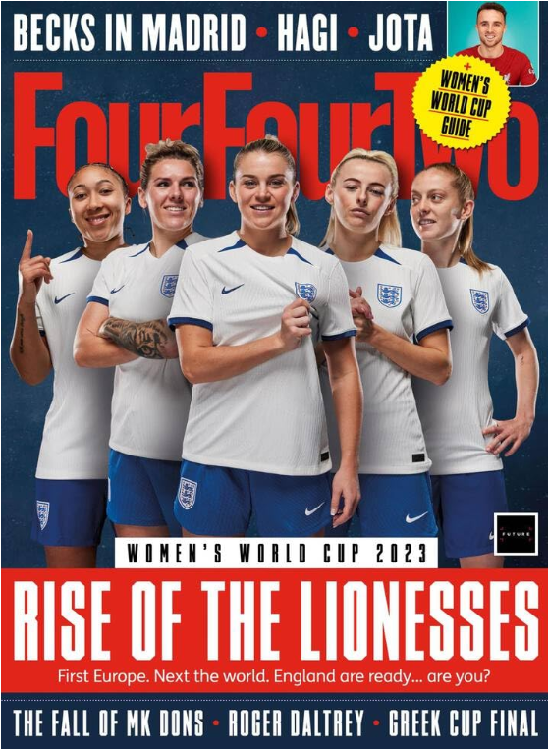
QUESTION FIVE
Which of the five players on the cover of FourFourTwo is the captain? The first, second, third, fourth or fifth, left to right?

Slide 7
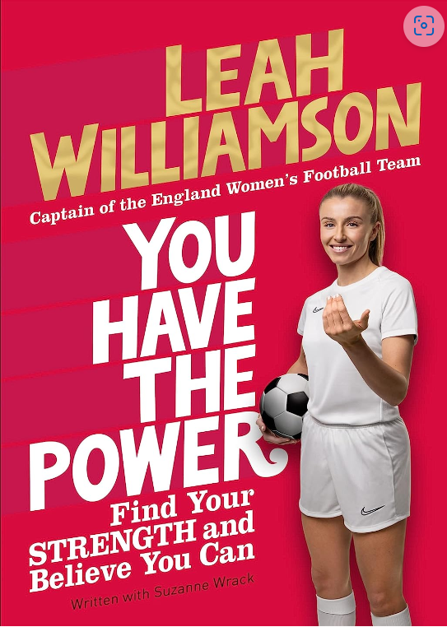
QUESTION SIX
Sadly, both Mead and Williamson will miss the World Cup. But they have written books for us to enjoy. What leg injury have the both been ruled out by?

Slide 8
QUESTION SEVEN
The most famous football film and book for years is about the women’s game. What word has been blacked out?

Slide 9
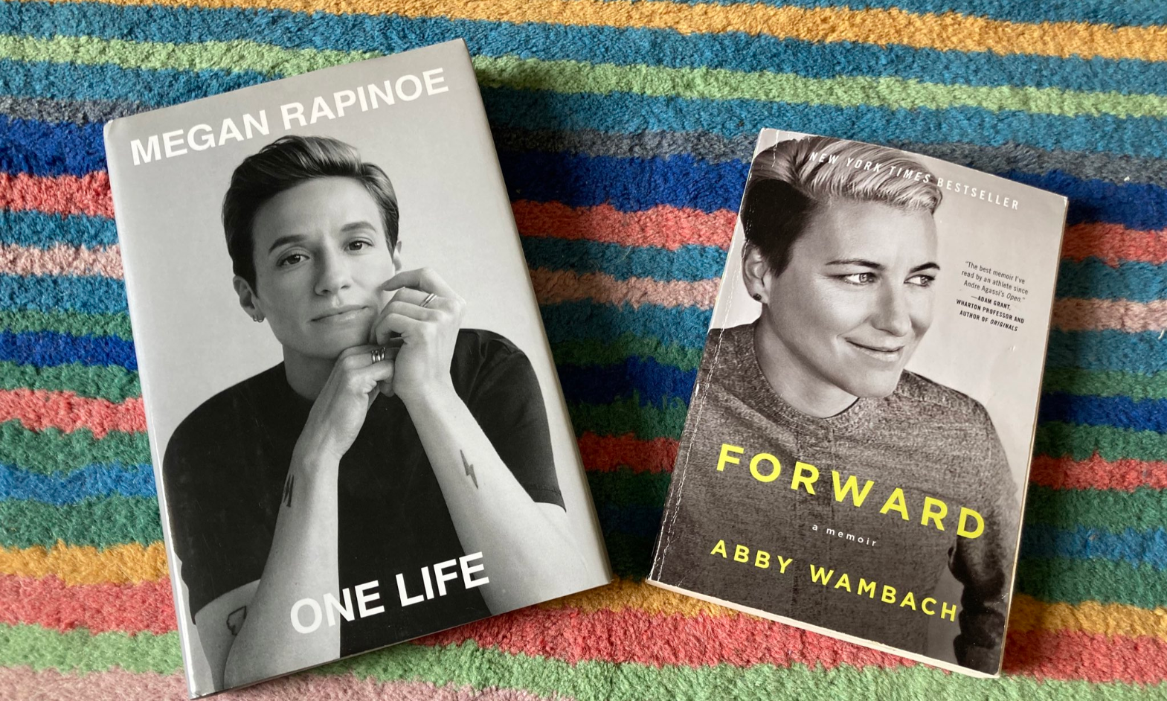
QUESTION EIGHT
Rapinoe and Wambach are two of the most celebrated footballers of the 21st century. What country did they represent?

Slide 10
QUESTION NINE
What word has been blacked out from the title of this Ultimate Football Heroes book?

Slide 11
QUESTION TEN
I play for which team?
Muncaster United
Melchester Rovers
Mystal Palace

Slide 12
Answers
1 Arsenal
Chloe Kelly
One
Carter
Two
Beckham
USA
Knee
Lionesses
Melchester Rovers

Slide 13
To find out more about me, please visit www.tompalmer.co.uk/rocky
Thank you for playing!

