Slide 1
Arctic Star
Tom Palmer

Slide 2

Author – Tom Palmer
I am a father, husband, author, football fan and a reader. In fact, it was reading about football that changed my life.
I wasn’t keen on reading when I was young. My mum was worried about me because I was struggling at school.
She encouraged me to read about football in newspapers, magazines and books. Gradually I came to love books.
And, from that point, my life changed. I wanted to know everything about books.
I went to night school to do A levels when I was 21. Then I did a degree in European Literature when I was 24. It was brilliant!
After I had graduated, I went to work in a bookshop, then a library, then I managed book festivals. All that time I was writing: stories, poems, diaries and books for adults.
Then – after a few years – I was lucky enough to have one of my football books for children accepted by Puffin.

Slide 3
Pre-Reading Activities
Arctic Star by Tom Palmer - who provided some of these tasks on his website!

Slide 4
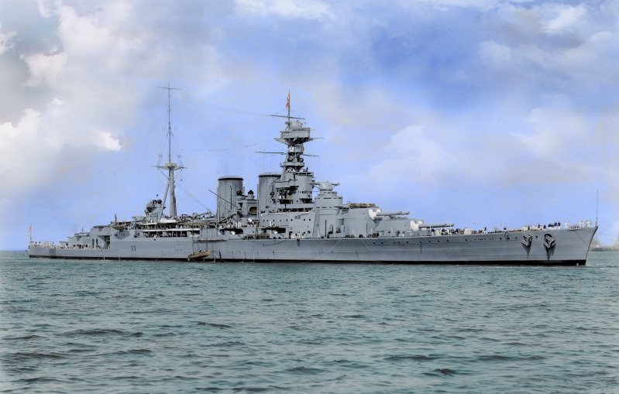
Think!
Have you ever read a book or watched a movie that was set during WW2?
Have you ever read a book or watched a movie that had characters facing difficult problems?

Slide 5
Before we read
We will look at the cover NOT the blurb
We will infer information based on the image and characters we see
We will consider aspects that may present in the book
AT THE END
You will complete a research project

Slide 6
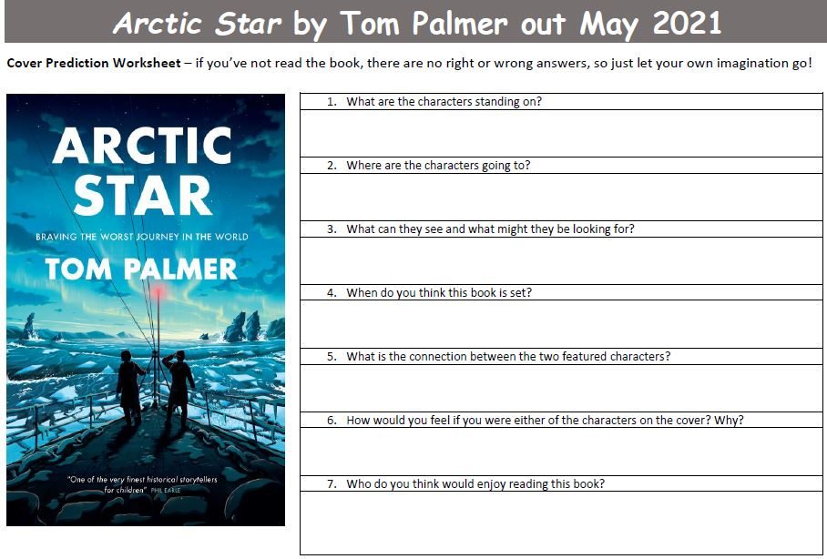
Predictions

Slide 7
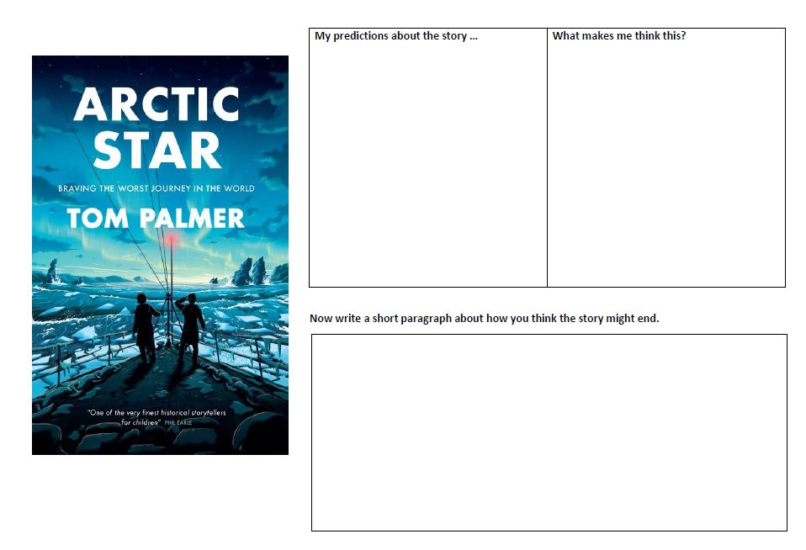
Predictions Continued

Slide 8
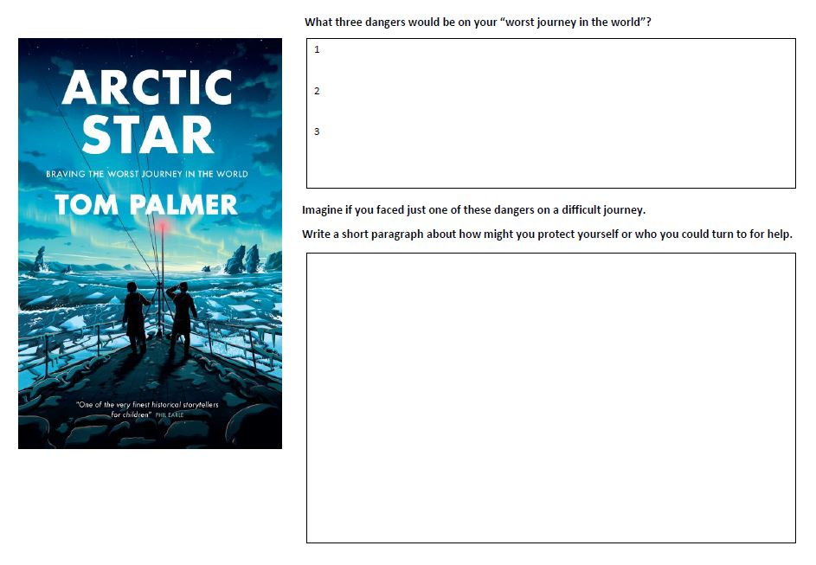
Predictions Continued

Slide 9
Read Chapters
One & Two
Then attempt RUAE questions

Slide 10
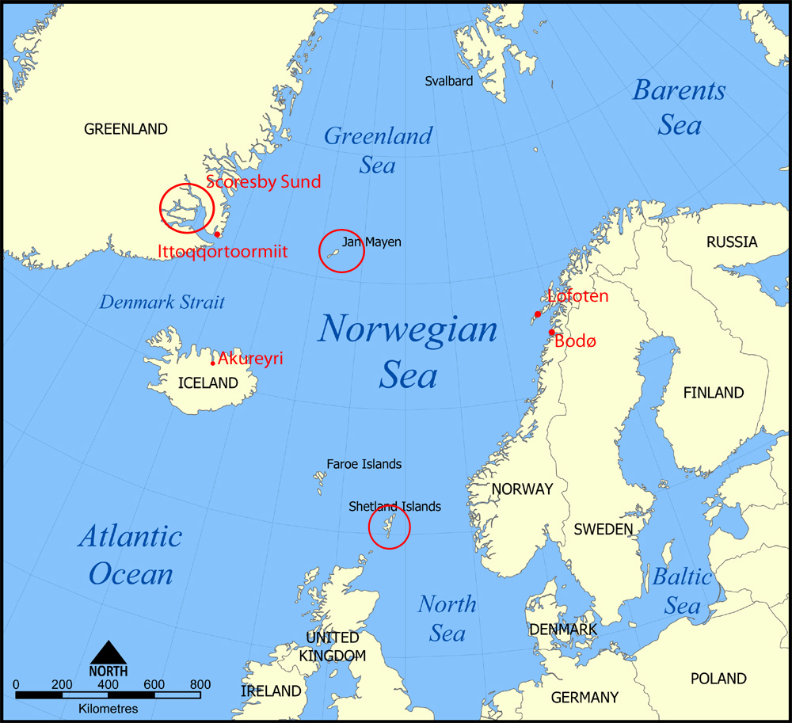
Chapter one
Frank, Stephen and Joseph are dealing with clearing the ice away from the deck the their ship- the HMS Forgetmenot.
Ice has to be cleared or the ship might capsize.
Weather conditions are bad and the boys are in danger…

Slide 11
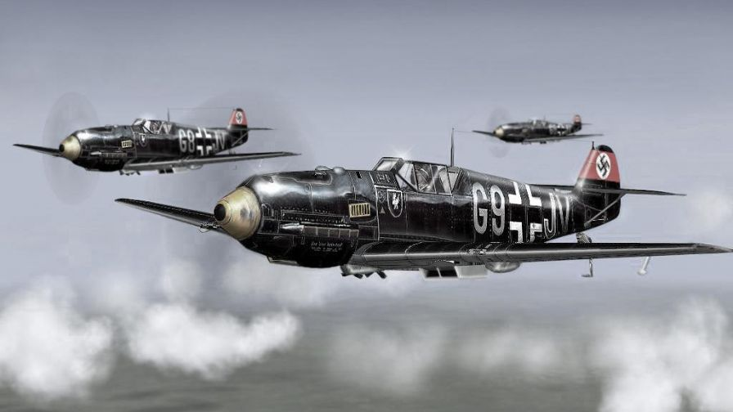
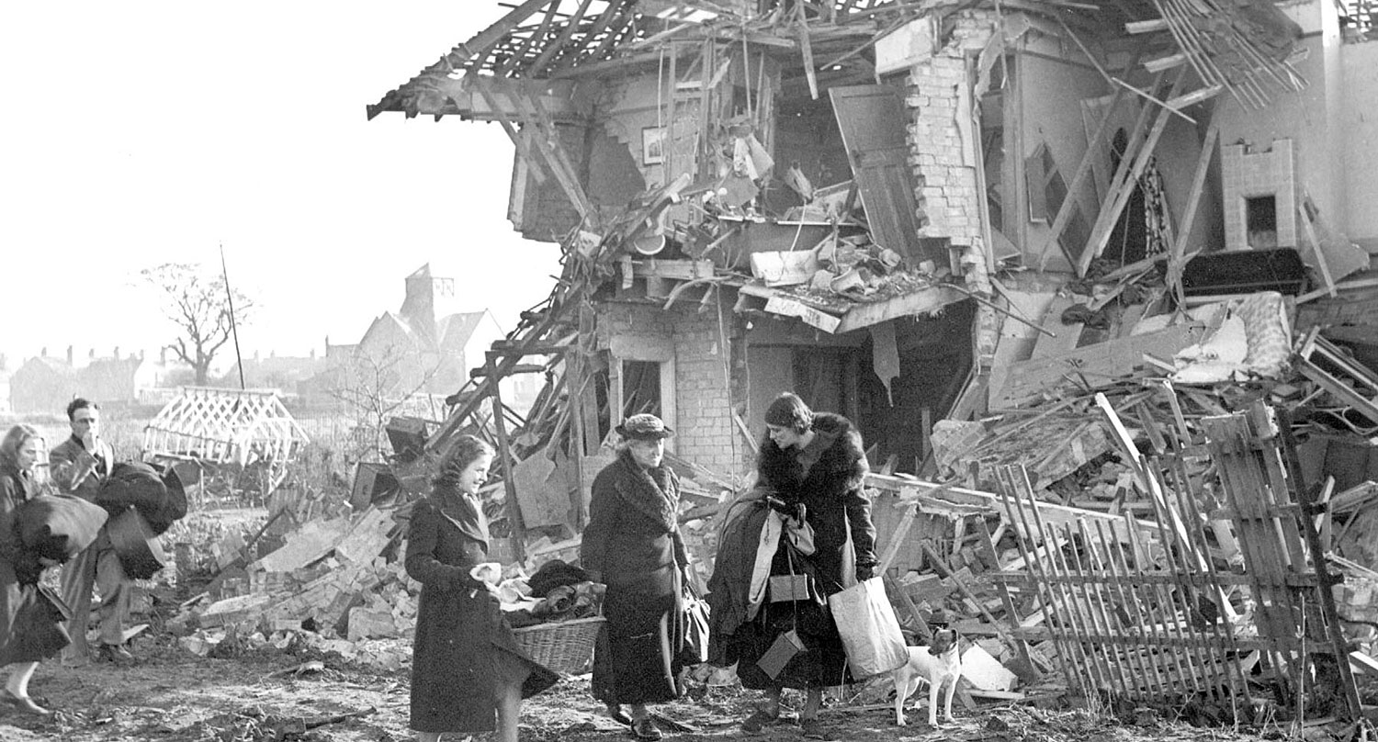
Chapter Two
Plymouth was heavily bombed by the Germans during WW2. The Royal Naval base was a key target.

Slide 12
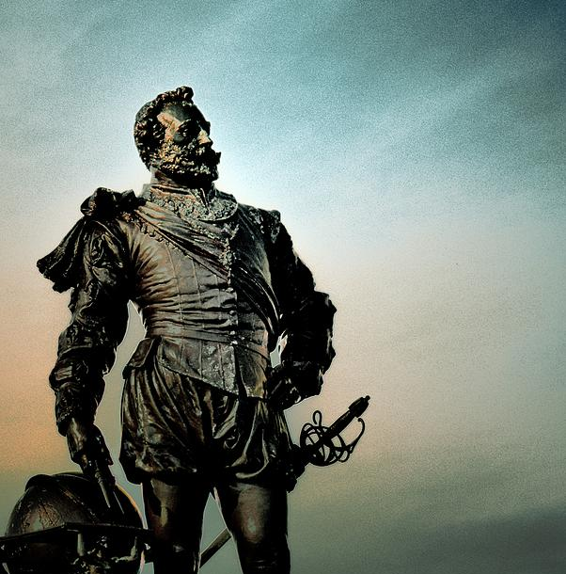
Chapter Two
* The eleven plus was an exam that you took in P7. If you passed you went to Grammar school, if you failed you went to state school. This exam is no longer taken in the UK
Sir Francis Drake was famous for sailing around the world in one journey. He is treated as a hero in England but the Spanish thought he was a thieving pirate. The King of Spain offered a huge reward for his capture!

Slide 13
Chapters One & Two
1. Where and when is chapter one set?
2. The author uses a simile to describe the arctic conditions – quote the simile and explain the comparison pg3
3. Name the ship that Frank is on, what he is doing and why? Pg 3
4. What adjectives does the author use to explain how Frank felt when he went overboard? Can you think of three more? Pg 6
5. The setting changes in chapter two – where is it and why does it change?
6. Why did Frank have a lot of time on his hands and what did he do with that time? Pg 9
7. What ship did Frank not sketch and why? Pg 13
8. What memory did Frank reflect on as the cold water took hold of him? Pg 14

Slide 14
Chapters One & Two Answers
1. Where and when is chapter one set? Norwegian Sea
2. The author uses a simile to describe the arctic conditions – quote the simile and explain the comparison pg3 Shards of ice hit him like a hail of bullets
Just as a hail of bullets would cause pain in many areas of your body so too do the shards of ice hitting Frank!
3. Name the ship that Frank is on, what he is doing and why? Pg 3
HMS Forgetmenot – clearing ice to stop them sinking
4. What adjectives does the author use to explain how Frank felt when he went overboard? Can you think of three more? Pg 6 pounding/gasping/shivering (yours)
5. The setting changes in chapter two – where is it and why does it change?
Plymouth – reflecting on why he joined the Navy
6. Why did Frank have a lot of time on his hands and what did he do with that time? Pg 9
He sat at the foot of Sir Francis Drake statue observing and drawing all the Navy ships coming in to port.
7. What ship did Frank not sketch and why? Pg 13 HMS Belfast as it’s location was meant to be kept secret!
8. What memory did Frank reflect on as the cold water took hold of him? Pg 14 – His mum’s anger and love

Slide 15
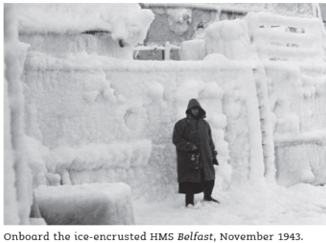
HMS Belfast
Here is a picture of the HMS Belfast covered in ice.
Write 3 adjectives that you would use to describe the ship.
This picture is from Tom Palmer’s website. Thank you Tom!

Slide 16
Writing in different formats

Slide 17
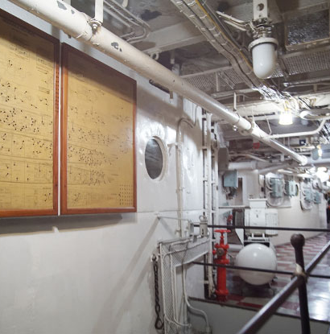
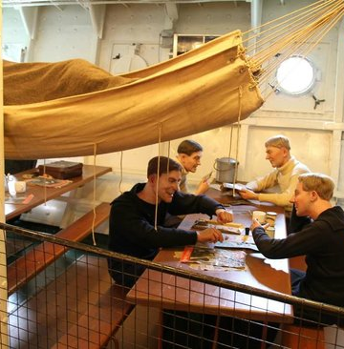
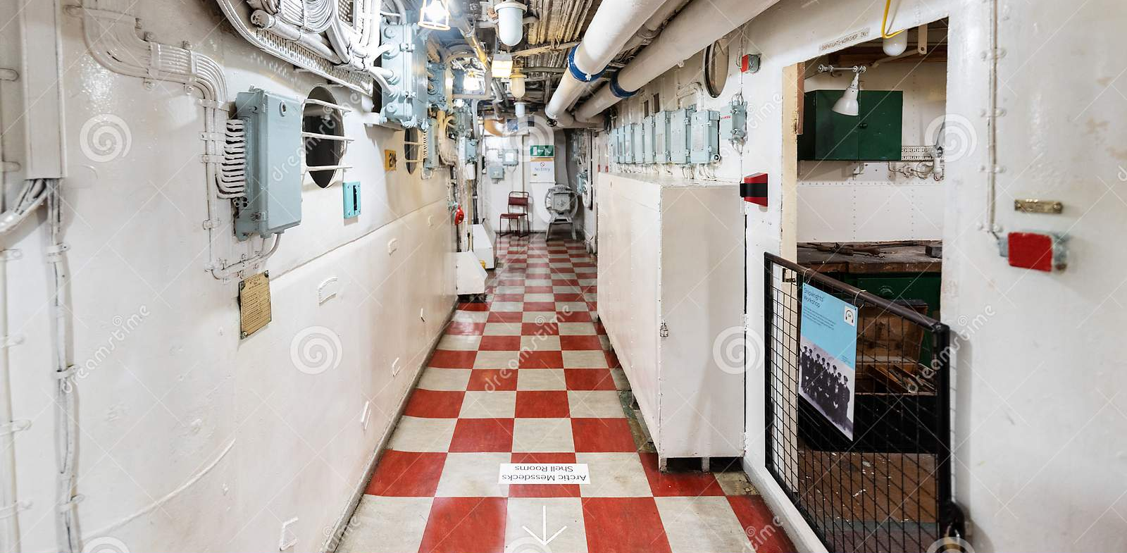
HMS Belfast
These are interior pictures of the HMS Belfast. Write a sentence describing each picture.
How would you describe the corridors?
How would you describe the sleeping area?

Slide 18
Picture One

Slide 19
Picture Two

Slide 20
Picture Three

Slide 21
Diary Entry
In your jotter write a diary entry from Frank’s point of view.
You will write about events leading up to his accident. How do you think Frank feels on this day.
What would he say to his friends?
How does he feel about having to go outside?
“like a hail of bullets”
Tom Palmer uses a simile here. Can you make up your own to describe the weather?
Here are some starter sentences to help:

Slide 22
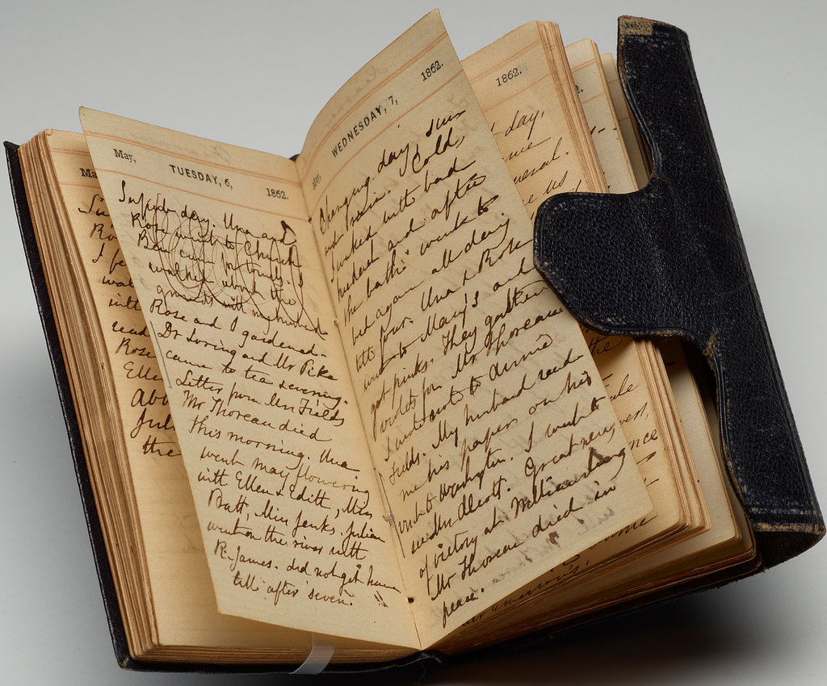
Diary Entry
5th October 1943
I woke up in my hammock as usual, I felt really…..
Stephen and Joseph joined me at breakfast. Stephen looked as if……
As we walked along the…
I turned the wheel of the heavy door and pushed. I was outside it was a cold as…..

Slide 23
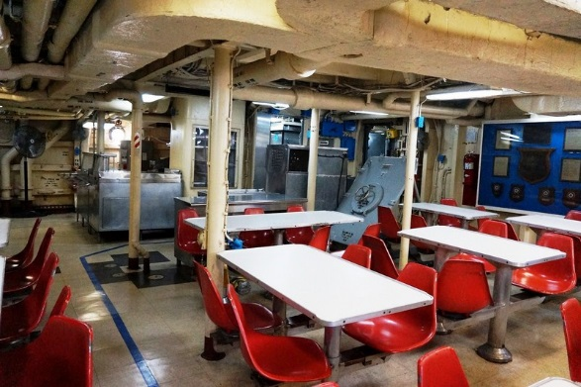
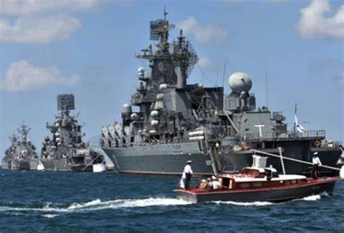
Definitions
Mess- where the Naval officers socialise, eat and sometimes live.
Convoy: A group of ships travelling together for protection.

Slide 24
Chapter Three
Read this then write a letter taking on the persona of Frank!
You must write to his mum explaining what happened and how he survived!
Mention the weight of his kit
The freezing temperatures
How he thought of her
The rescue and who was with him
Where he is heading now and how he is feeling about it?

Slide 25
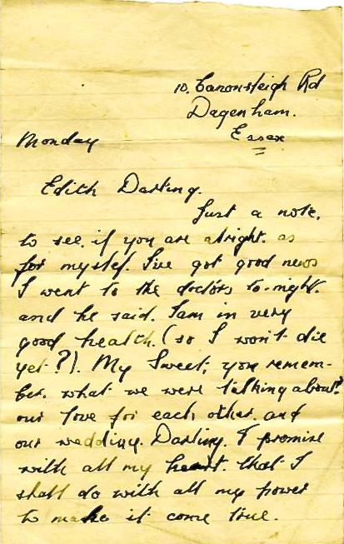
What do you notice about the format of the letter?

Slide 26
Prompt for Frank’s letter
Mum,
You won’t believe how heavy our outdoor clothing is. I can barely see when we get outside….

Slide 27
Read Chapter
Four
Then attempt RUAE questions

Slide 28
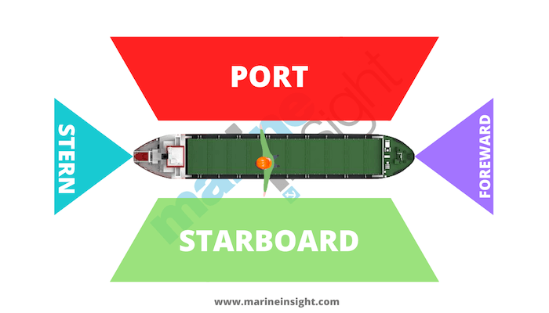
Sides of a ship

Slide 29
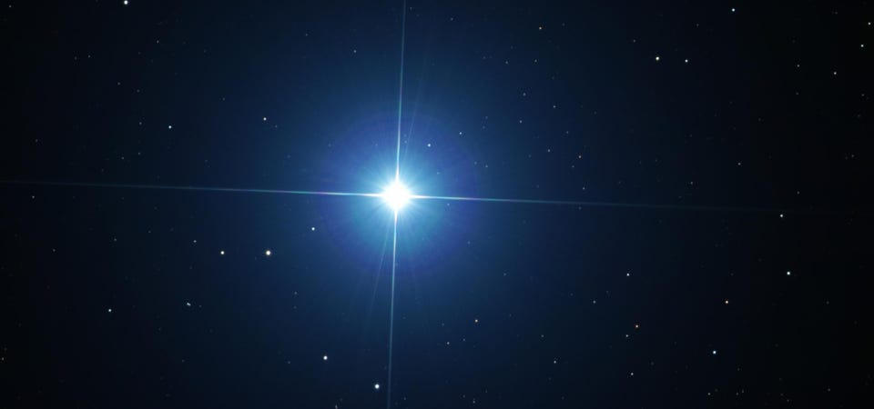
North star

Slide 30
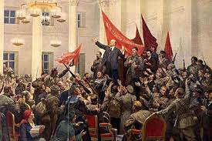
The October Revolution

Slide 31
Chapter Four
1. How many ships were sailing the Arctic Ocean? What were they carrying? For whom and why? Pg 23
2. Why was Frank anxious about hearing a foreign voice? Pg 24
3. What is ‘Kye’? Pg 24
4.How many languages does Joseph speak and what are they? Pg 25
5. Who was prime minister of Britain (Leader) and which Royal figure is referenced? Pg 27

Slide 32
Chapter Four Answers
1. How many ships were sailing the Arctic Ocean? What were they carrying? For whom and why? Pg 23 6x8 = ?
2. Why was Frank anxious about hearing a foreign voice? Pg 24
Foreigners could be spies
3. What is ‘Kye’? Pg 24 Hot chocolate drink
4.How many languages does Joseph speak and what are they? Pg 25 4 English, French, German & Russian
5. Who was prime minister of Britain (Leader) and which Royal figure is referenced? Pg 27 Winston Churchill & The King

Slide 33
Read Chapter
Five
Pair and share task
Talk

Slide 34
Chapter Five – Before Reading
What do you consider the most dangerous job in the world – why?
The three boys find it funny trying to think of ways they could die in their current job – thinking about the setting and the type of characters they are discuss with a partner how many you can think of?
Can you get TEN?
Let’s read chapter five and find out how many you guessed?

Slide 35
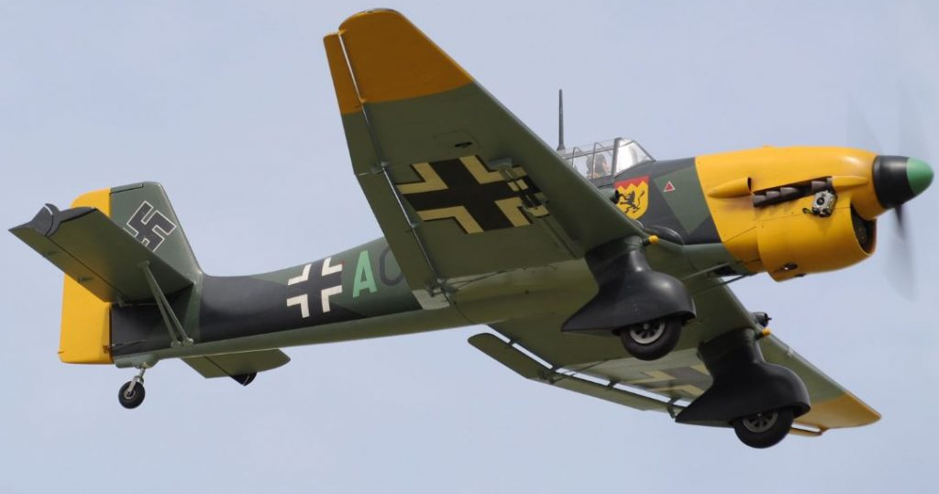
A Stuka
Stephen imagines being killed by a bomb from a Stuka- a German ‘dive bomber’ plane.

Slide 36
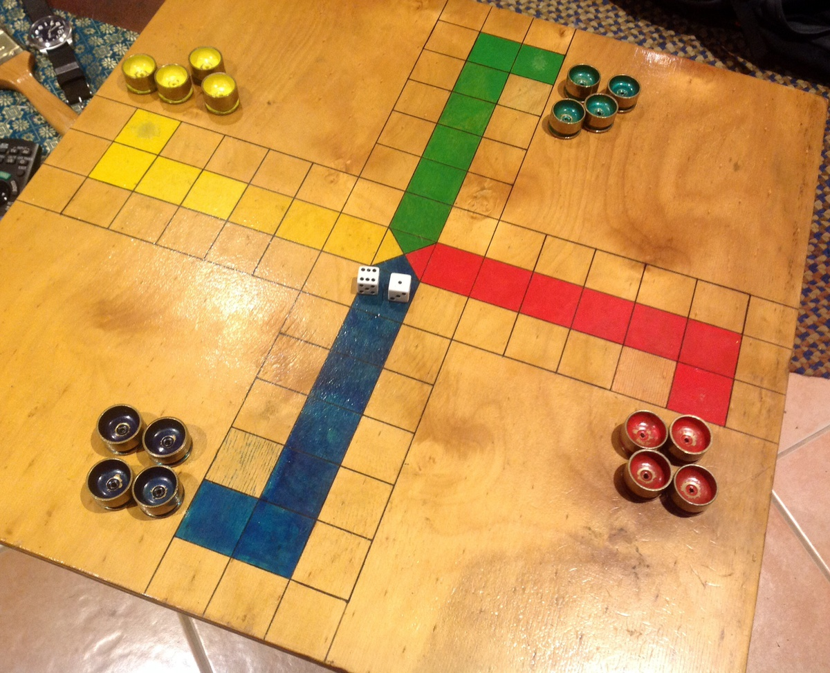
Uckers
Uckers is like Ludo. Each player has to get their counter round the board and back home again.
Sailors have been playing Uckers for roughly 120 years!

Slide 37
Read Chapters
Six and Seven
Language task – vocabulary in context

Slide 38
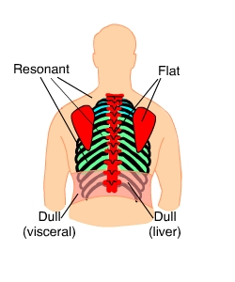
Chapters Six and Seven Vocabulary
Write each word and the meaning in your jotter – if you do not know then look it up in a dictionary! Then: Use that word in a different sentence using it in the correct context.
enraged scenarios Now the fun part!
resonant visibility Using your ipad create a PPT one slide per word
droning collided and insert the word and an image like so:
intermittent freight Resonant - Adjective
silhouette navigating
reconnaissance treacherous
summon illuminated
detonated projection
manoeuvred Production of sound/prolonged sound

Slide 39

Silhouette
Noun: the dark shape and outline of someone or something visible
in restricted light against a brighter background.
Verb: cast or show (someone or something) as a dark shape and
outline against a brighter background.

Slide 40
Read Chapters
Seven and Eight
Then attempt RUAE questions

Slide 41
Chapters seven and eight
1. Where is the bridge of a ship located and why? Pg 45
2. Find and explain the two similes on pg 47
3. Describe your thoughts on the list created by repetition on pg 48
4. Illustrate the scene created on pg 51
5. From chapter eight – write sentences using the following words – bonus points if you can relate them to ships/naval pursuits
casualties, extraordinary, Communist, infectious, evolve, atmosphere, gyrate, idyllic, discipline,

Slide 42
Chapters seven and eight answers
1. Where is the bridge of a ship located and why? Pg 45
Top deck towards the front to allow the best view of the sea and the sky.
2. Find and explain the two similes on pg 47
“He spotted tanks lined up like children’s toys on a table”
Just as children line up toy cars etc so too the tanks were lined up on the ships in front of him
“With the wind and sea in turmoil, it was like the air was half water.”
Just as wind and water create movement so too the water is drawn into the air
3. Describe your thoughts on the list created by repetition on pg 48
No cover… no roof… no ceiling… no windows = no protection from the elements/ very dangerous
4. Illustrate the scene created on pg 51
5. From chapter eight – write sentences using the following words – bonus points if you can relate them to ships/naval pursuits
casualties, extraordinary, Communist, infectious, evolve, atmosphere, gyrate, idyllic, discipline,

Slide 43
Illustrating your interpretation of events

Slide 44
Illustrations
Teenagers Frank and Stephen are Royal Navy recruits on their first mission in the Arctic Ocean during the Second World War.
They are on the lookout for danger : icebergs and enemy ships, airplanes and submarines.
There is also a chance they might see marine life - whales, dolphins, seabirds or even the Northern Lights.
List what you think they will see and how they feel when they see it?
Draw and colour what you think they can see on their lookout today.

Slide 45
Illustrations
In “Arctic Star”, young Royal Navy recruits served on HMS Belfast. They were in a famous sea battle during the Second World War – fighting a combined attack from airplanes and submarines and the German battleship Scharnhorst.
Draw and colour the planes in the sky and submarines in the sea below and whatever else you imagine around them.

Slide 46
Read Chapter
Nine
Attempt Russian Language
&
Identify language techniques used by Tom Palmer

Slide 47
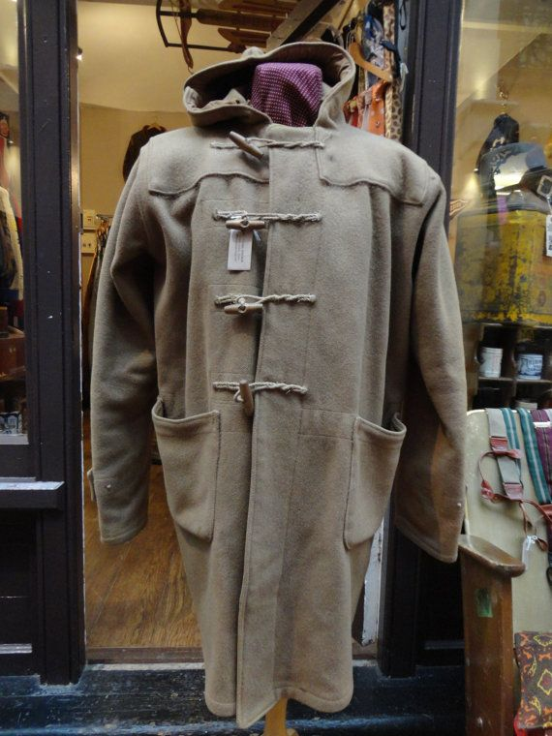
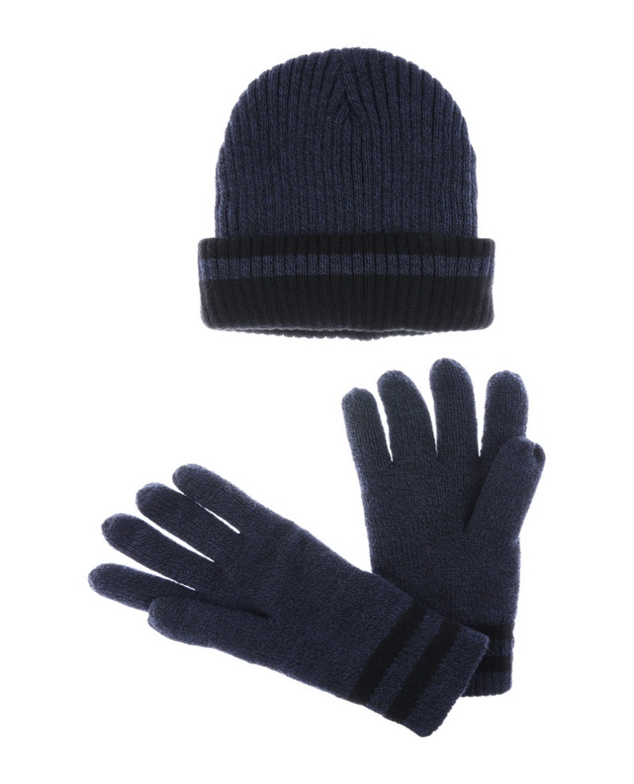
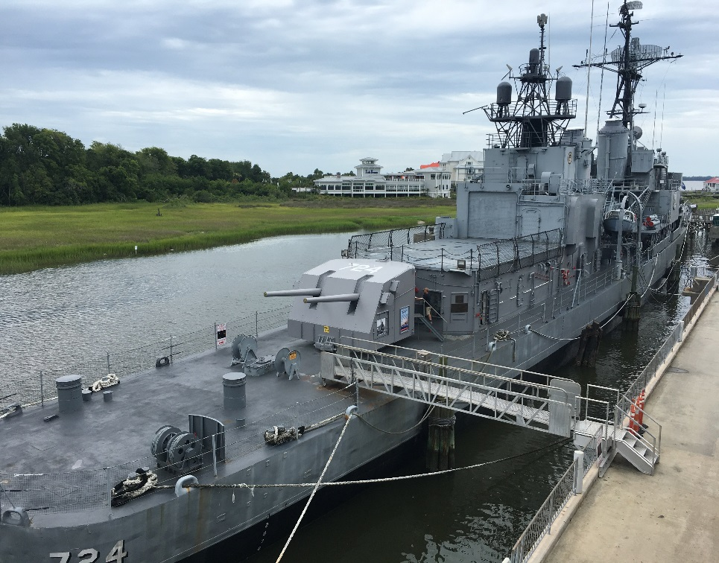
Chapter Nine
Hat and Gloves
Duffle Coat
Gangway

Slide 48
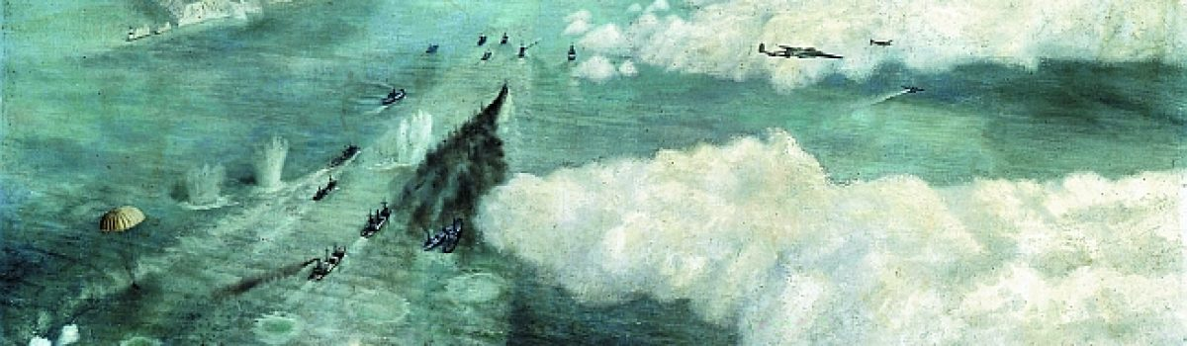
The Murmansk Run: Running the Gauntlet of WWII’s Arctic Convoys
No battlefront in the entire war was perhaps more dangerous than WWII's arctic convoys—including the icy, infamous Murmansk Run.
It was unbelievably dull and uncomfortable duty, often interspersed with moments of sheer terror and the possibility of sudden and violent death. This was the Murmansk Run, the convoy duty on the North Atlantic.
Thousands of cargo ships, manned by tens of thousands of brave British, Canadian, and American civilian merchant mariners, along with Navy and Coast Guard personnel, made the hazardous voyages carrying invaluable supplies to America’s chief Allies—Great Britain and the Soviet Union—months before, and years after, the United States was propelled into the war on December 7, 1941.
The voyages across the North Atlantic and from Iceland to the Russian ports of Murmansk, Archangel, and Kola Inlet involved more hazards than in any other kind of naval duty. Severe weather was commonplace. Ice fields could be encountered at any time of year. Floating mines were a constant menace. German submarines, surface craft, and warplanes could strike at will from nearby bases in German-occupied Norway. And, prior to the spring of 1943, when an effective Allied antisubmarine offensive got underway, ships and men making the so-called “Murmansk Run” had about one chance in three of returning.
By Flint Whitlock

Slide 49
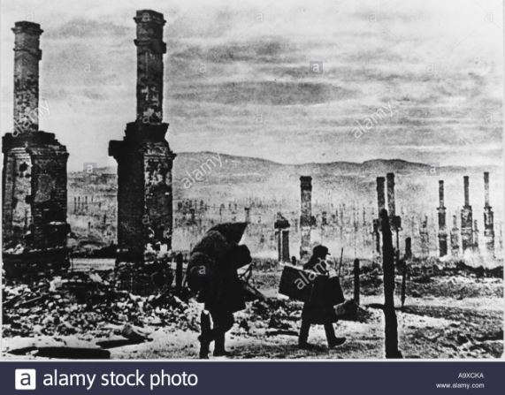
MURMANSK DURING WW11

Slide 50
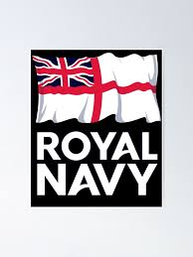
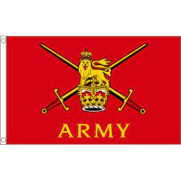
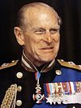
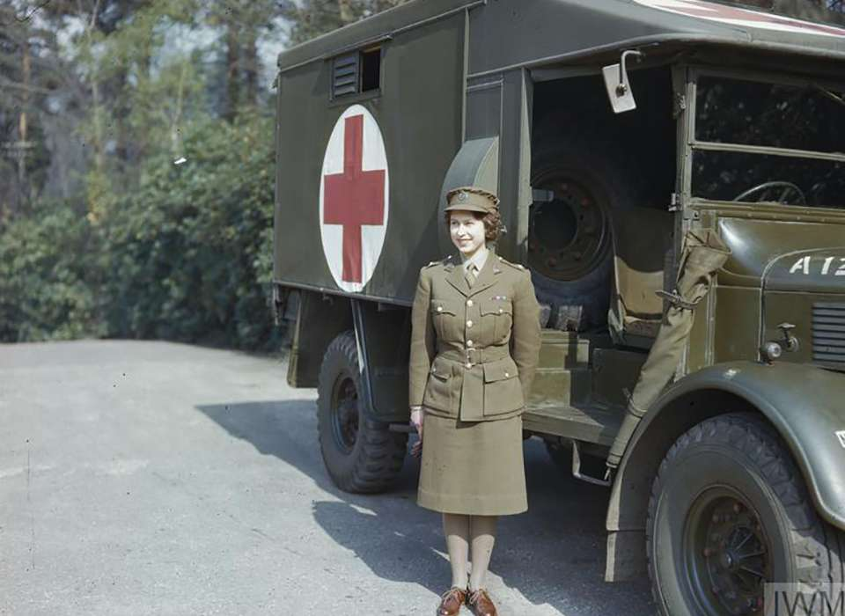

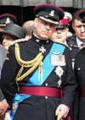
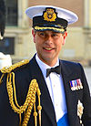
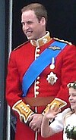
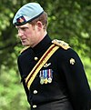
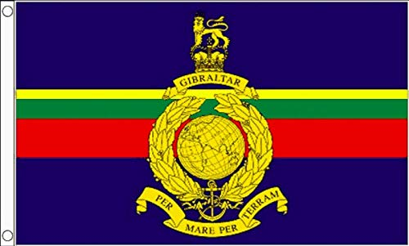
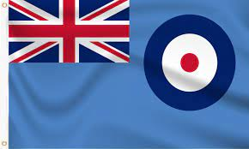
Royals and the military
Queen Elizabeth II
Auxiliary Territorial Service, British Army
1945–1949
Subaltem (Army Lieutenant), Junior Commander (Army Captain)
Prince Phillip
Duke of Edinburgh
Royal Navy, British Army and RAF – 1940 -1952 - Commander
Prince Charles
Prince of Wales
Royal Navy, British Army and RAF 1971 -1976
Commander, Flight Lieutenant
Prince Andrew
Duke of York Royal Navy & RAF
1980 -2001
Commander
Prince Edward
Earl of Sussex
Royal Marines
1986 -1987
Lieutenant
Prince William
Duke of Cambridge
Royal navy, British Army and RAF
2005 – 2013
Lieutenant, Captain & Squadron Leader
Prince Harry
Duke of Sussex
British Army
2005 – 2015
Captain

Slide 51
Chapter Nine
Murmansk: the edge of the earth
Murmansk is the largest city in the world north of the Arctic Circle. Its name probably derives from the local Sami word murman, meaning “the edge of the earth.” Pop. (2005 est.)
Good morning! – Доброе утро! – Dobroye utro!
Good afternoon! – Добрый день! – Dobryy den!
Good evening! – Добрый вечер! – Dobryy vecher!
Good night! – спокойной ночи! – Spokoynoy nochi!
Hello! – Здравствуйте! – Zdravstvuyte!
How are you? – Как дела? – Kak dela?
Very good. Thank you – Хорошо. Спасибо. – Horosho. Spasibo.
What is your name? – Как тебя зовут? – Kak tebya zovut?
My name is Mondly. – Меня зовут Мандли. – Menya zovut Mandli.
Nice to meet you. – Рада познакомиться. – Radа poznakomitsya.

Slide 52
Chapter Nine -Techniques
A list – usually noticeable by use of commas
A question - ?
An example of repetition – a word or expression repeated once or more
A simile – comparing one thing to another using the word like or as
An example of contrast – two opposing views
A Metaphor – comparing one thing to another without the use of like or as

Slide 53
Read Chapters
Ten and Eleven
Then attempt RUAE questions
and vocabulary challenge

Slide 54
Chapter Ten
1. Thinking of what you’ve read so far – why do you think you have to keep your
wits about you in a naval town? Pg 69
2. What word is similar in meaning to companion/friend/colleague? Pg 69
3. Was joseph drawing attention a positive or negative thing for them? Why? Pg 70
4. Find a word similar in meaning to barbeque? Pg 71
5. “He began to boil with anger at his friend.” What technique is this and can you think of an alternative? Pg 73
6. Why do you think joseph’s face drained of colour? Pg 74

Slide 55
Chapter Ten - Answers
1. Thinking of what you’ve read so far – why do you think you have to keep your
wits about you in a naval town? Pg 69
You never know if people are spies
2. What word is similar in meaning to companion/friend/colleague? Pg 69
Comrade
3. Was joseph drawing attention a positive or negative thing? Why? Pg 70
Negative as people may have thought he was a spy
4. Find a word similar in meaning to barbeque? Pg 71
Brazier
5. “He began to boil with anger at his friend.” What technique is this and can you think of an alternative? Pg 73
Metaphor – Joseph’s actions made Frank’s temperature soar!
6. Why do you think joseph’s face drained of colour? Pg 74
He was afraid of the men

Slide 56
Chapter Eleven – Vocabulary Challenge
The sentence challenge - use each word in the correct context – each sentence must start with a different word and contain exactly seven words!
One sentence can be a question ‘?’
One can be an exclamation ‘!’
Extension task: Try to find an alternative words with similar meaning
immobilised ominous exhaled captors resistance
exhaustion forbidding stench adrenaline euphoric
pathetic devastated

Slide 57
Read Chapter
Twelve
Then attempt RUAE questions

Slide 58
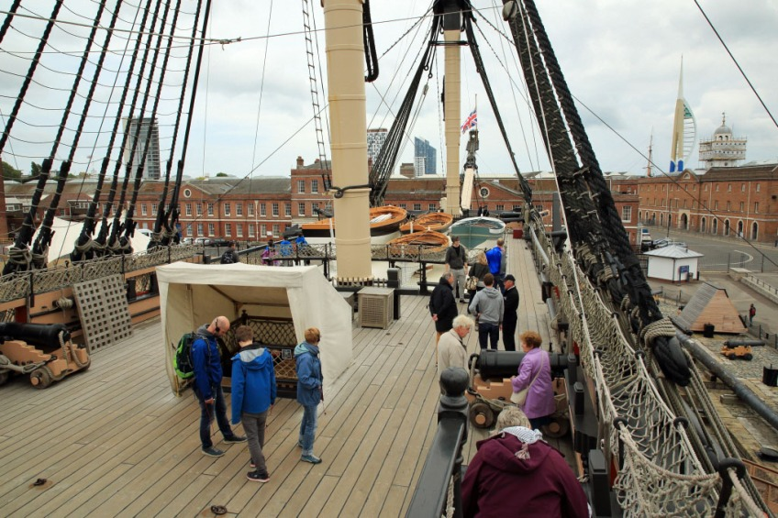
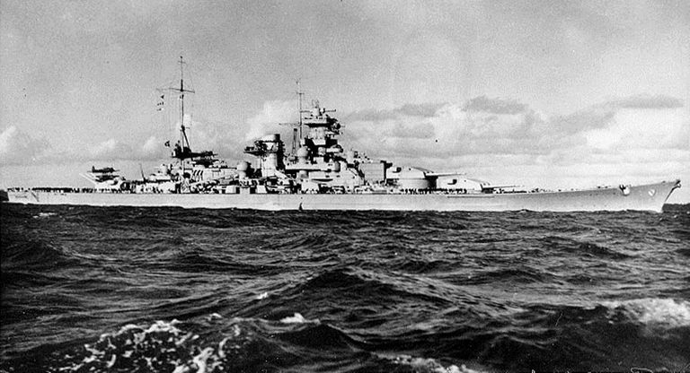
Chapter Twelve
HMS VICTORY QUARTERDECK @PORTSMOUTH
THE SCHARNHORST

Slide 59
Chapter Twelve
1. Why did Captain Whitaker think they may have a quieter journey home? Pg 87
2. Find and explain the metaphor relating to submarines pg 87
3. Why were the crew desperate to avoid an encounter with ‘The Scharnhorst’?pg 88
4. What caused the air to change at sea? Pg 90
5. Why were sailors nervous about dropping metal utensils or laying their metal mugs down too hard? pg 92
6. What brought Frank swiftly out of his daydream about cruise liners? Pg 96

Slide 60
Chapter Twelve Answers
1. Why did Captain Whitaker think they may have a quieter journey home? Pg 87
They were carrying wood which wasn’t as interesting to the Germans.
2. Find and explain the metaphor relating to submarines pg 87
Just as wolves travel in packs so too there are many uboats under the water waiting to attack.
3. Why were the crew desperate to avoid an encounter with ‘The Scharnhorst’?pg 88
It was the most feared German vessel and an encounter most likely resulted in death and the sinking of your ship.
4. What caused the air to change at sea? Pg 90
The warm water of the Gulf Stream hitting the frozen air of the Arctic.
5. Why were sailors nervous about dropping metal utensils or laying their metal mugs down too hard? pg 92
The submarines couldn’t see them in the dark but their listening equipment could locate them placing them in danger.
6. What brought Frank swiftly out of his daydream about cruise liners? Pg 96
He spotted a torpedo Starboard Bow – side on

Slide 61
Chapter Thirteen
Read and summarise this chapter
Ensure you add lots of adjectives to describe what happens
You should aim for at least two paragraphs
Try to capture the mood for the reader.

Slide 62
Events of Chapter Thirteen
Frank is feeling upset that Joseph refuses to speak to him after their argument. He goes about his duties thinking of how he get restore their friendship. There are a few incidents where ethe men are on edge when the chef drops a metal utensil and a hammer or something is also dropped in the engine room but, thankfully they remain safe and undetected. This doesn’t last long as Frank screams for all to hear that a torpedo is heading their way. The captain does his best to avoid it causes sharp movement of the ship which led to some falling overboard.
It was inevitable – they had been hit and the drenching doors were closed meaning all in the engine room would die. Following a second hit Frank decides his only chance at survival is to jump overboard into the icy cold waters and swim for his life. He does this and struggles to move due to his heavy clothing but he spots another sailor and reaches him only to discover that it is Joseph. He clutches him with all his might trying to keep him safe but, when the cargo net dropped to haul them in he realises Joseph is dead and he is forced to release his lifelong friend to the depths of the sea so he can save himself.

Slide 63
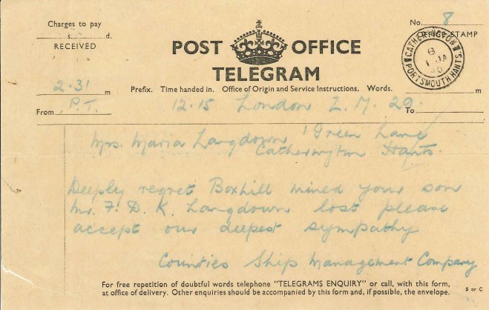
Chapter Fourteen
Write a telegram to Joseph’s dad informing him of what happened to his son.

Slide 64
Chapter’s Fifteen and Sixteen
Work with your shoulder partner to find as much evidence of the war in Plymouth as you can.
Next write a definition of PTSD then…
List any evidence you can to suggest that Frank is suffering from PTSD

Slide 65
Read Chapters
Seventeen and Eighteen
&
complete the vocabulary challenge

Slide 66
Chapters Seventeen & Eighteen Vocabulary
The sentence challenge - use each word in the correct context – each sentence must start with a different word and contain exactly nine words! You can use a suffix or prefix!
One sentence can be a question ‘?’
One can be an exclamation ‘!’
billowing bloodshot impressed heroic emotion intensified
infested colossal ploughed predict swooping aspect
Extension task: Try to find an alternative words with similar meaning!

Slide 67
Read Chapters
Nineteen and Twenty
Then attempt RUAE questions

Slide 68
Chapters Nineteen & Twenty RUAE
1. What did Frank have for his first Christmas dinner without his mum? Pg 153
2. Why did HMS Belfast not dock at Murmansk? Pg 154
3. After the crew listened to the Kings Speech “Frank felt shatter but energised too” try to identify what technique the writer has used here and explain what made Frank feel Energised as much as he was tired. Pg 156
4. In what way does Stephen use tone to boost the confidence of his fellow crew members. Pg 157
5. Identify the technique and explain the reason for this happening “he felt his throat seal up like the hatches on the ship were being sealed right now”. Pg 160
6. Once again Stephen cracks jokes to lighten the mood – what does he call Frank? Do you think he meant this? Pg 161
7. Why was Frank relieved that three cruisers were travelling together? Pg 164
8 “Know that the prayers of our nation and families are with you tonight” write one word about how this must have made the men feel? Pg 165

Slide 69
Chapters Nineteen & Twenty Answers
1. What did Frank have for his first Christmas dinner without his mum? Pg 153
Bully beef sandwich and dried biscuits
2. Why did HMS Belfast not dock at Murmansk? Pg 154
They had to meet up with and shield the next convoy heading North.
3. After the crew listened to the Kings Speech “Frank felt shatter but energised too” try to identify what technique the writer has used here and explain what made Frank feel Energised as much as he was tired. Pg 156
Oxymoron (two words of opposite meaning) thinking of home made him feel energised
4. In what way does Stephen use tone to boost the confidence of his fellow crew members. Pg 157
He sings changing the lyric to a well known hymn “Peace on Earth, but not on water. Schnarnhorst, Belfast might have caught yer.”
5. Identify the technique and explain the reason for this happening “he felt his throat seal up like the hatches on the ship were being sealed right now”. Pg 160
Simile – Frank is anxious as they are about to engage in battle with The Schnarnhorst
6. Once again Stephen cracks jokes to lighten the mood – what does he call Frank? Do you think he meant this? Pg 161
Clown – no he was trying to reassure him that they were real friends for life.
7. Why was Frank relieved that three cruisers were travelling together? Pg 164
He felt there was safety in numbers and that they’d have a better chance of defeating the Schnarnhorst.
8 “Know that the prayers of our nation and families are with you tonight” write one word about how this must have made the men feel? Pg 165
Proud/honoured/brave/heroic

Slide 70
The Final Attack
Chapters Twenty One & Twenty Two
It took the Navy five ships in total to bring down the German ship ‘The Scharnhorst’
HMS BELFAST – Town class light cruiser
HMS NORFOLK – County class heavy cruiser
HMS SHEFFIELD – Type 42 guided missile destroyer
HMS JAMAICA – Fiji-class cruiser
HMS DUKE OF YORK – King George V – class battleship
Using A3 paper illustrate and annotate this scene

Slide 71
Final Thoughts – from author, “Tom Palmer”
Of the 2000 German Sailors on board ‘The Schnarnhorst’ only 36 were rescued by the Royal Navy!
The sinking of this ship whilst tragic helped bring WW11 to an end saving millions from enduring war, death, slavery and suffering.
HMS Belfast went on to play a pivotal role in D-Day invasions aiding the liberation of France and other countries.
A long campaign ensued to get recognition for those who in the words of Churchill, “endured the worse journey in the world”
They initially received the Atlantic star but campaigning continued and in 2013 they were awarded a more significant medal in honour of their service ‘The Arctic Star Medal’

Slide 72
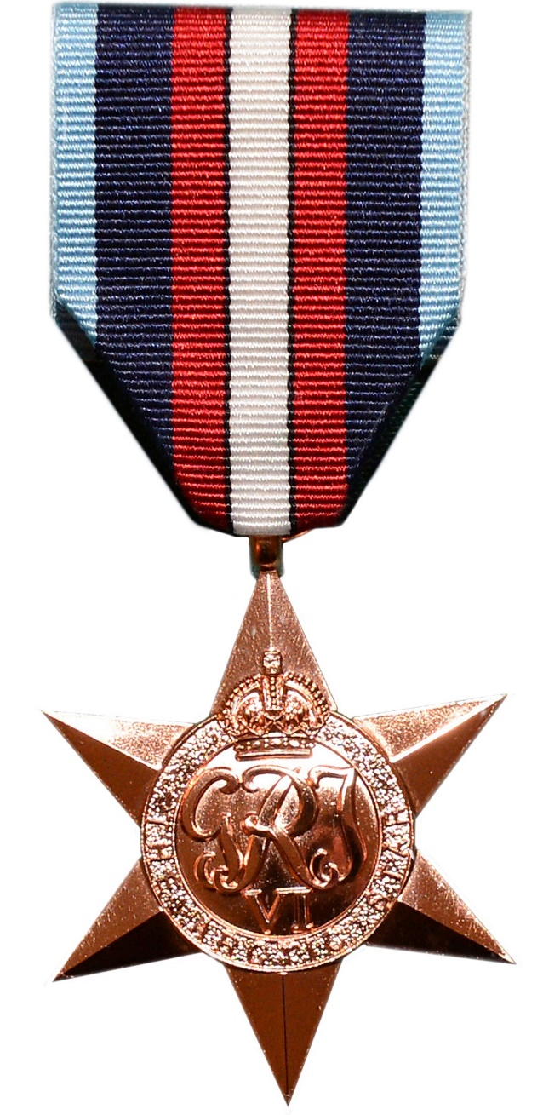
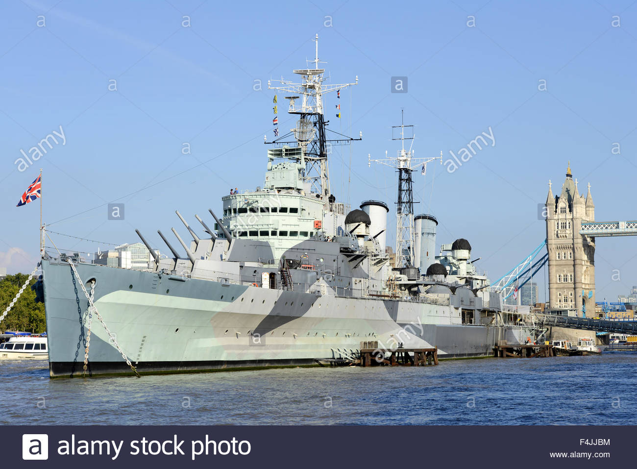
HMS Belfast
Arctic Star Medal

Slide 73
HMS BELFAST
https://www.iwm.org.uk/history/hms-belfast-and-the-arctic-convoys
ARCTIC CONVOYS
https://www.iwm.org.uk/history/a-5-minute-history-of-arctic-convoys
RUSSIAN ARCTIC CONVOY MUSEUM
https://racmp.co.uk/
ROYAL NAVY RESEARCH ARCHIVE
http://www.royalnavyresearcharchive.org.uk/

Slide 74
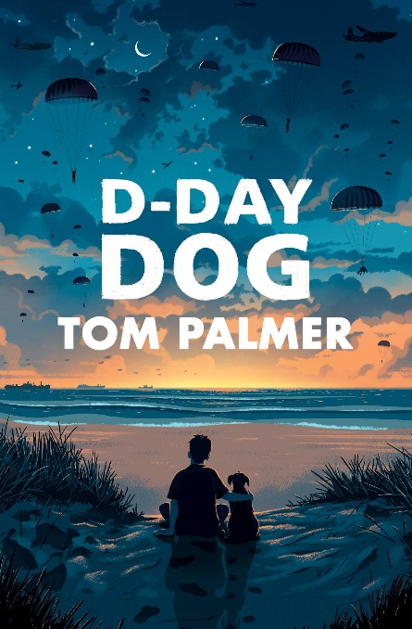
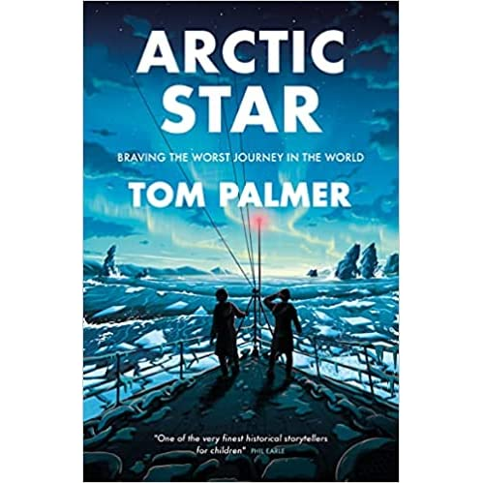
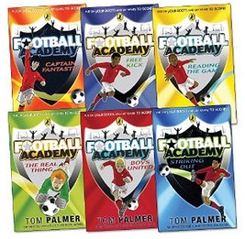

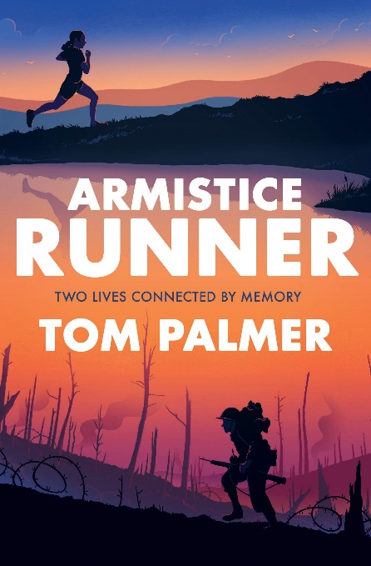
Other books by Tom Palmer https://tompalmer.co.uk/

Slide 75
Arctic Star- Final Task
Write a critical response to the text answering the following question:
With reference to ‘Arctic Star’ explain how the author creates a realistic account of war for the reader. You must refer to language techniques and use quotes from the text for this one!
Write a creative story linked to war using this title:
“The wind. The waves. The danger.”
Create a storyboard account of ‘Arctic Star’

