Slide 1
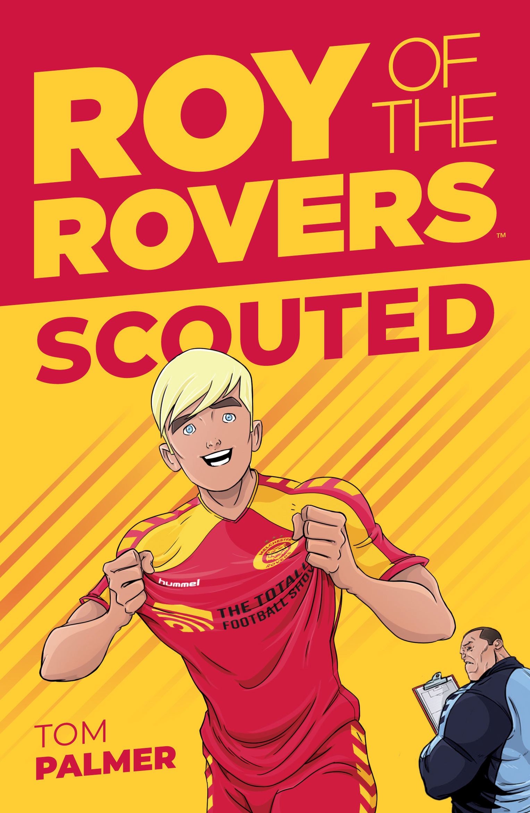
Roy of the Rovers by Tom Palmer
Being a young carer –
a theme explored in
“This is much more than a book about the beautiful game it also has everything that today’s children need as they grow up. It is jam-packed with positive role models, girls involvement in Women’s Football, respect, mental well-being, good work ethic, education and aspiration. Tom Palmer expertly weaves all of this together with friendship, family and a great little plot.” Books for Topics

Slide 2
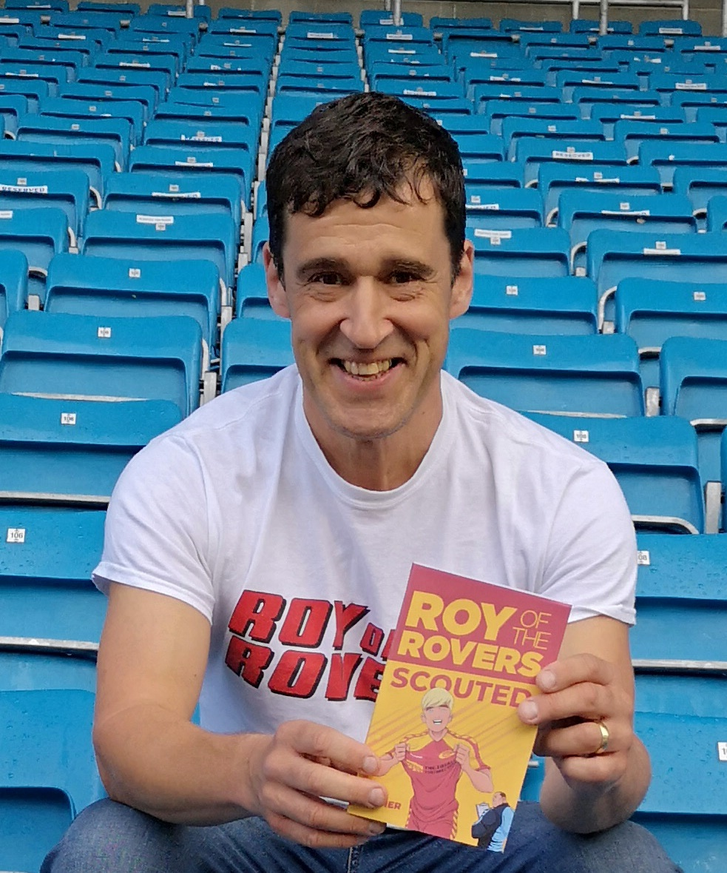
Who is Tom Palmer?
Tom Palmer is the author of 50 children’s books including the Football Academy, Foul Play, Rugby Academy, Wings and the Defenders series.
“Scouted is a wonderful book about pursuing your dreams whatever your circumstances. I love how Tom covers football alongside real life issues that some of our children face today. #welldone” @emmasuffield
School Librarian of the Year 2018

Slide 3
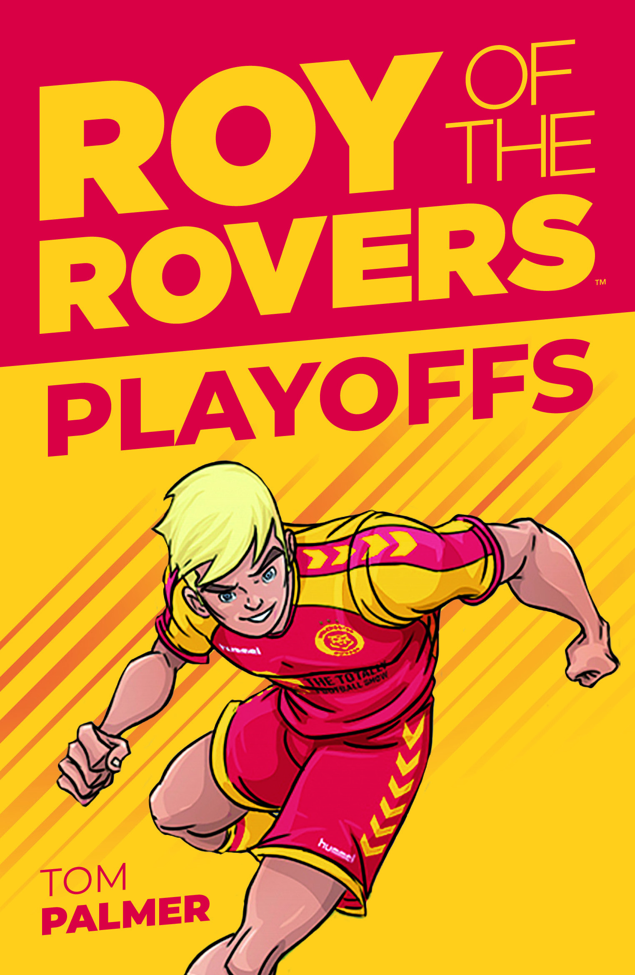
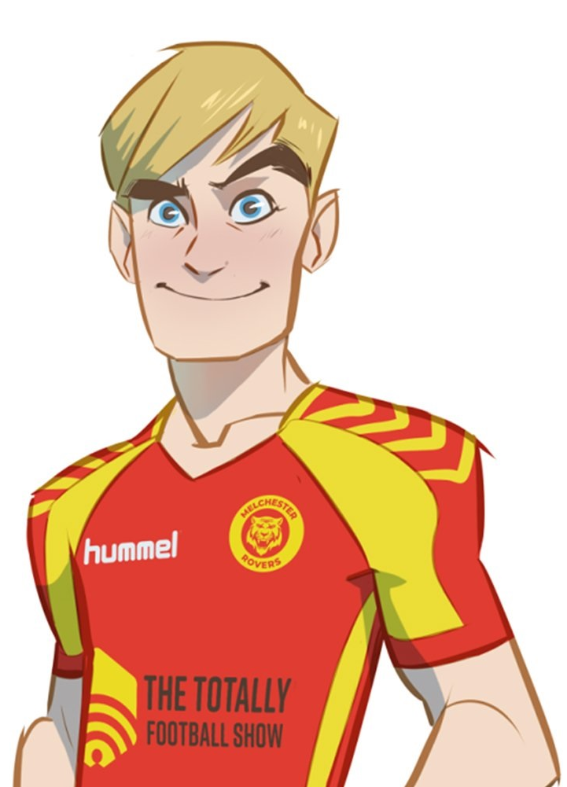
Interview with Tom about Roy of the Rovers
.
Q: What is Roy of the Rovers about?
Tom: Roy of the Rovers was a famous comic story from when I was young that we’ve brought right up to date. Roy is a promising sixteen-year-old footballer who has always dreamt of playing up front for his home team Melchester Rovers.
Q: How are young carers portrayed in Roy of the Rovers? Tom: Roy has to fit his school life and training around acting as young carer for his dad whilst his mum works to support the family
Q: Who are young carers? Tom: Young carers are children and young people who care for someone in their own home who is ill, has a physical or mental disability, or drug or alcohol dependency.

Slide 4
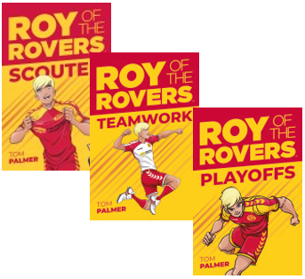
Roy of the Rovers – the series so far
1 Scouted (fiction) 2 Kick Off (comic) 3 Teamwork (fiction) 4 Foul Play (comic) 5 Playoffs (fiction) 6 Going Up (comic)
Illustrated by Lisa Henke
“Can’t endorse these books enough. They’ve given a legend a brilliant new lease of life and are absolutely PACKED with heart.” Phil Earle
Find out more about Roy of the Rovers here: http://tompalmer.co.uk/roy-of-the-rovers/

Slide 5
Extract 1:From Scouted by Tom Palmer, page 35
Back home, Roy showered, then, still feeling his post-exercise buzz, went into his parents’ room to find his dad sitting up in bed listening to the sports news on the radio.
Dad’s wheelchair was at the end of the bed where Roy had parked it the night before. Danny Race winked his right eye at Roy. People used to say that father and son looked alike, but that wasn’t the case anymore.
Roy was tall and lean with a flash of blond hair and a decent tan from spending the whole summer outside. His dad was pale and had lost a lot of weight. There was a long, stitched wound on the bald bit of his head that reminded Roy of zip. Danny Race was much changed since the operation that had turned his family’s life upside down.

Slide 6
Question 1:What has happened to Roy’s dad?

Slide 7
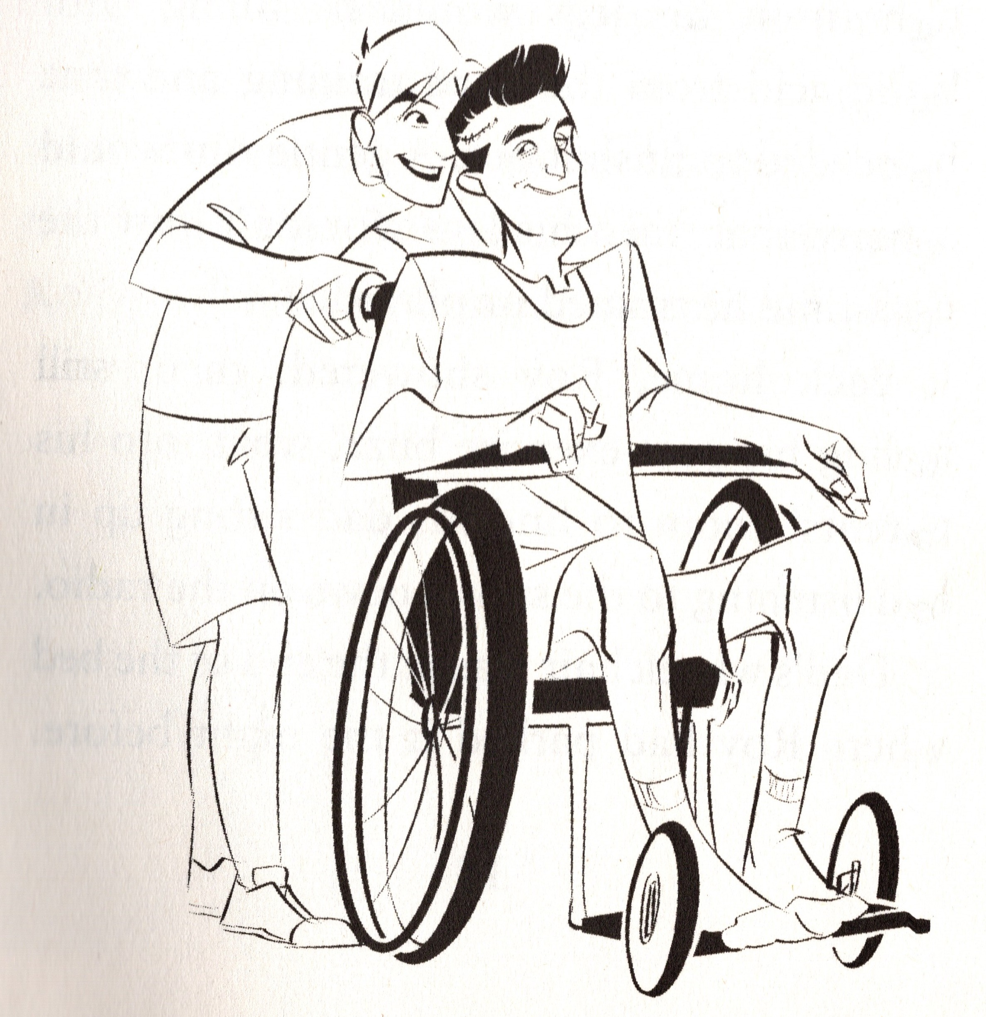
Suggested answer:
Question 1:What has happened to Roy’s dad?
From the text, we know that Roy’s dad, Danny Race has had an operation on his head. He has a wound that is healing, he is pale and he has lost weight. He has to use a wheelchair.
There is no speech between them and as it says in the text that Danny signals to his son winking with his right eye, perhaps this is one of the ways he can communicate now.
In the last sentence the writer says that the operation has turned the family’s life upside down so the reader has to conclude that it was a very serious operation.

Slide 8
Extract 2: From Scouted by Tom Palmer, page 37
Roy’s dad managed a half-smile, then he raised his right arm, signalling he wanted to go to the toilet. Roy helped his dad into his wheelchair. With only the right side of Danny Race’s body working, Roy needed to take the weight if his dad’s left side, putting his dad’s arm around his shoulder to ease his shoulder into his chair.
Wheeling Dad out of the bedroom to the bathroom Roy told him about being scouted for Melchester Rovers. He saw his dad’s light up.

Slide 9
Question 2: How does Roy help his Dad?

Slide 10
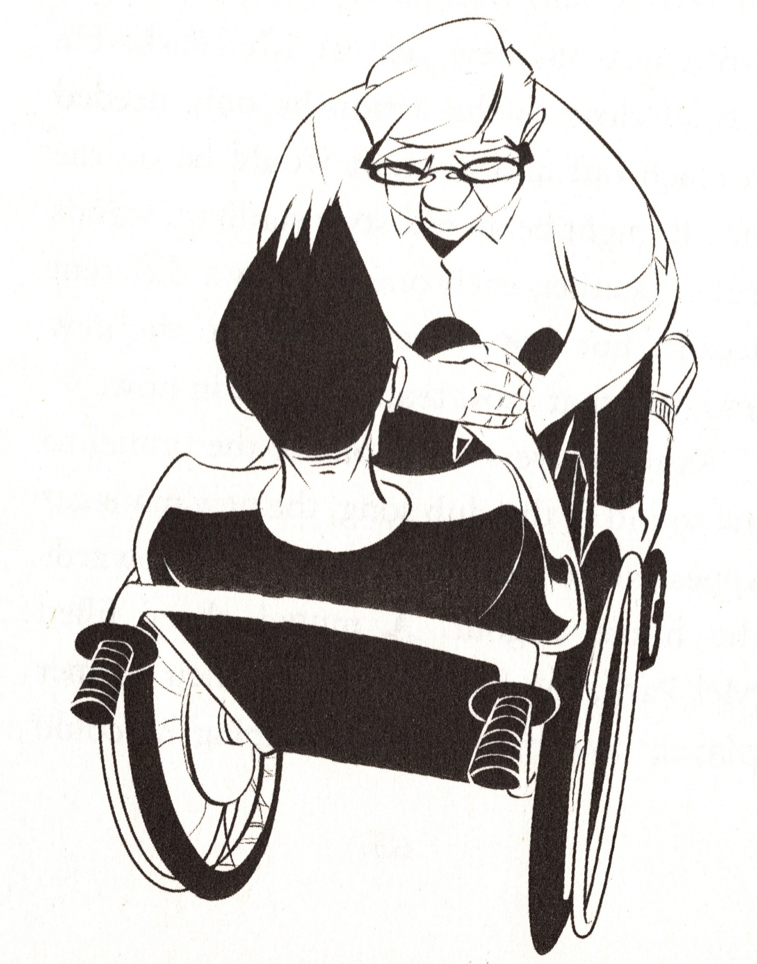
Suggested answer:
Question 2: How does Roy help his Dad?
Roy helps by:
Anticipating his dad’s needs
Understanding his dad’s communications
Physically helping him into the wheelchair
Talking to him about what is going on in his life

Slide 11
Extract 3: From Scouted by Tom Palmer, page 72
0-3.
Game over. There was no coming back.
Roy looked at his dad. His dad had his eyes closed. But he wasn’t asleep. His right fist was clenched so hard that his knuckles were bone-white. His jaw was rigid. But unlike in previous seasons, Dad was not shouting and letting out all his frustration.
How awful must that be? One of the best bits about going to the football was shouting your head off when it was going wrong, Roy thought.
But Danny Race would never shout again.
So, with that thought troubling him, Roy got up and shouted. The loudest, longest, most heart-felt howl of frustration that had ever come out of his mouth.

Slide 12
Question 3: How do you think Roy feels?

Slide 13
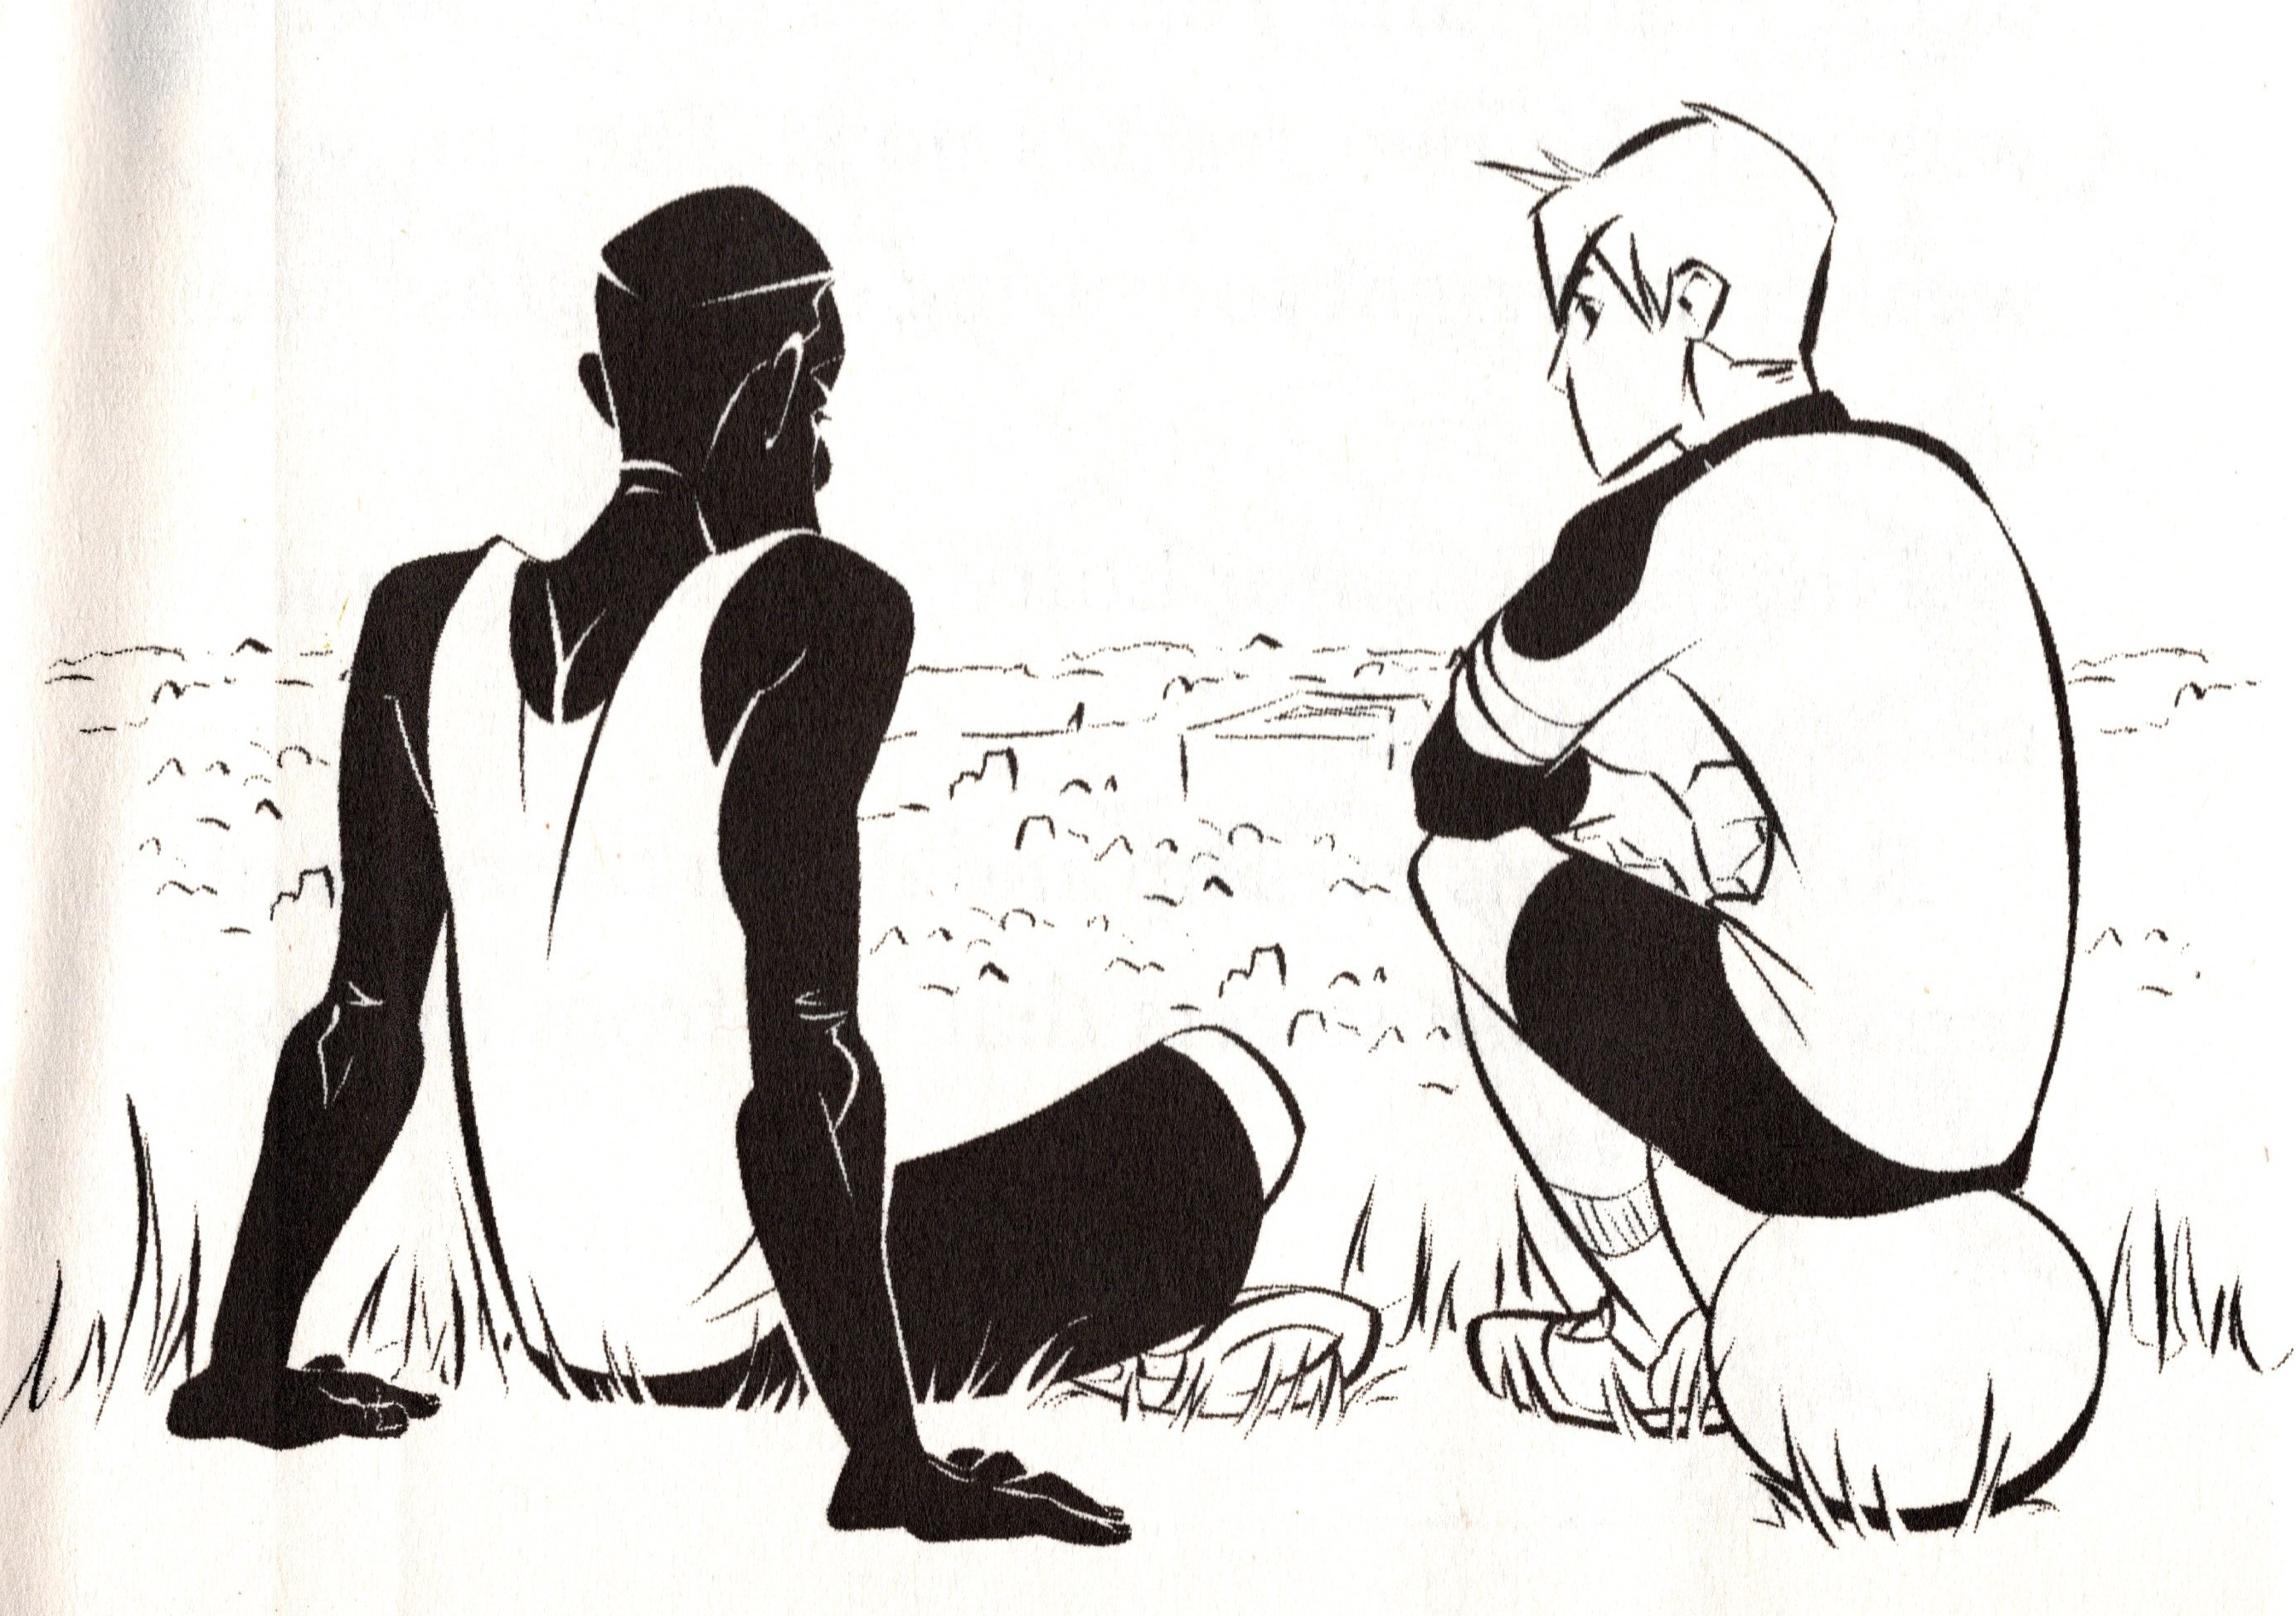
Suggested answer:
Question 3: How do you think Roy feels?
Roy feels :
Empathy for his dad and how he must be feeling
Frustrated that his team is losing
Troubled that his dad will never shout again
Sad for what this means for his family’s future

Slide 14
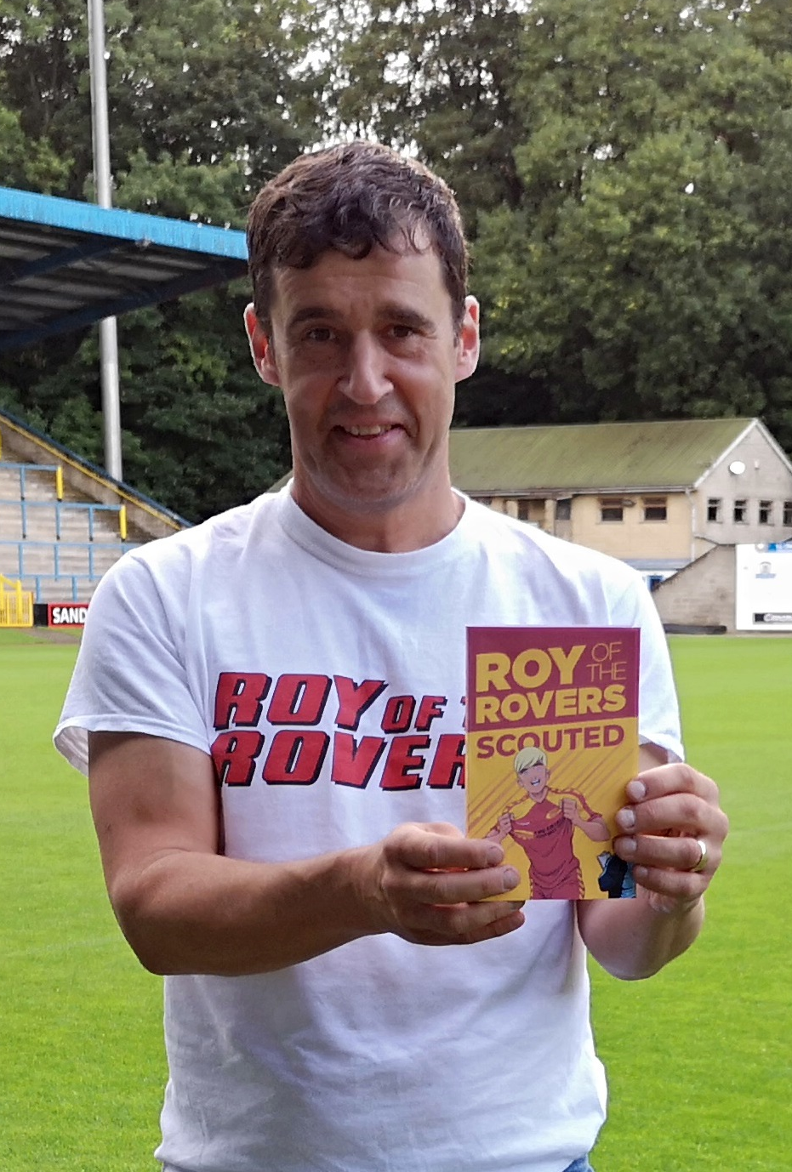
Interview with Tom about Roy of the Rovers
Why was it important to portray Roy as a young carer?
Tom: When I was young, my dad had the same condition as Roy’s dad. A brain tumour. An operation that paralysed him. A zip-like scar on his skull.
The next few months were tough. He was a big man. My mum needed me to help get him to the toilet, up and down the stairs and out to hospital appointments. He couldn’t speak, so it was difficult to know how to help him.
I wrote about Roy and his dad because I wanted to show how hard those months were. At the time I thought we were the only family going through this. Unfortunately young people being carers is common and I hoped writing this story would reach those families to let them know they are not alone.

Slide 15
Young Carers Facts
There are about 700,000 young carers in the UK.
Young carers :
look after a family member who is ill
look after younger siblings
do more chores
provide emotional support to the person they are caring for
have to learn how to nurse them or look after their personal needs like bathing and dressing
Young carers have the right to be looked after too and there are lots of places and people you can go to, to get help.

Slide 16
Young carers, you are not alone Your local council may have local support groups Please talk to your teachers. They can help …
Support you at school
Support your family
Identify local support groups with children like you
You will not be in trouble

Slide 17
Other places to turn …
www.barnardos.org.uk/what-we-do/helping-families/young-carers
www.nhs.uk/conditions/social-care-and-support-guide/support-and-benefits-for-carers/being-a-young-carer-your-rights/
wwwcarers.org/about-us/about-young-carers
www.youngminds.org.uk/find-help/looking-after-yourself/young-carers/
www.carersuk.org/help-and-advice/practical-support/getting-care-and-support/young-carers-and-carers-of-children-under-18
www.childrenssociety.org.uk/what-we-do/helping-children/young-carers

