Slide 1
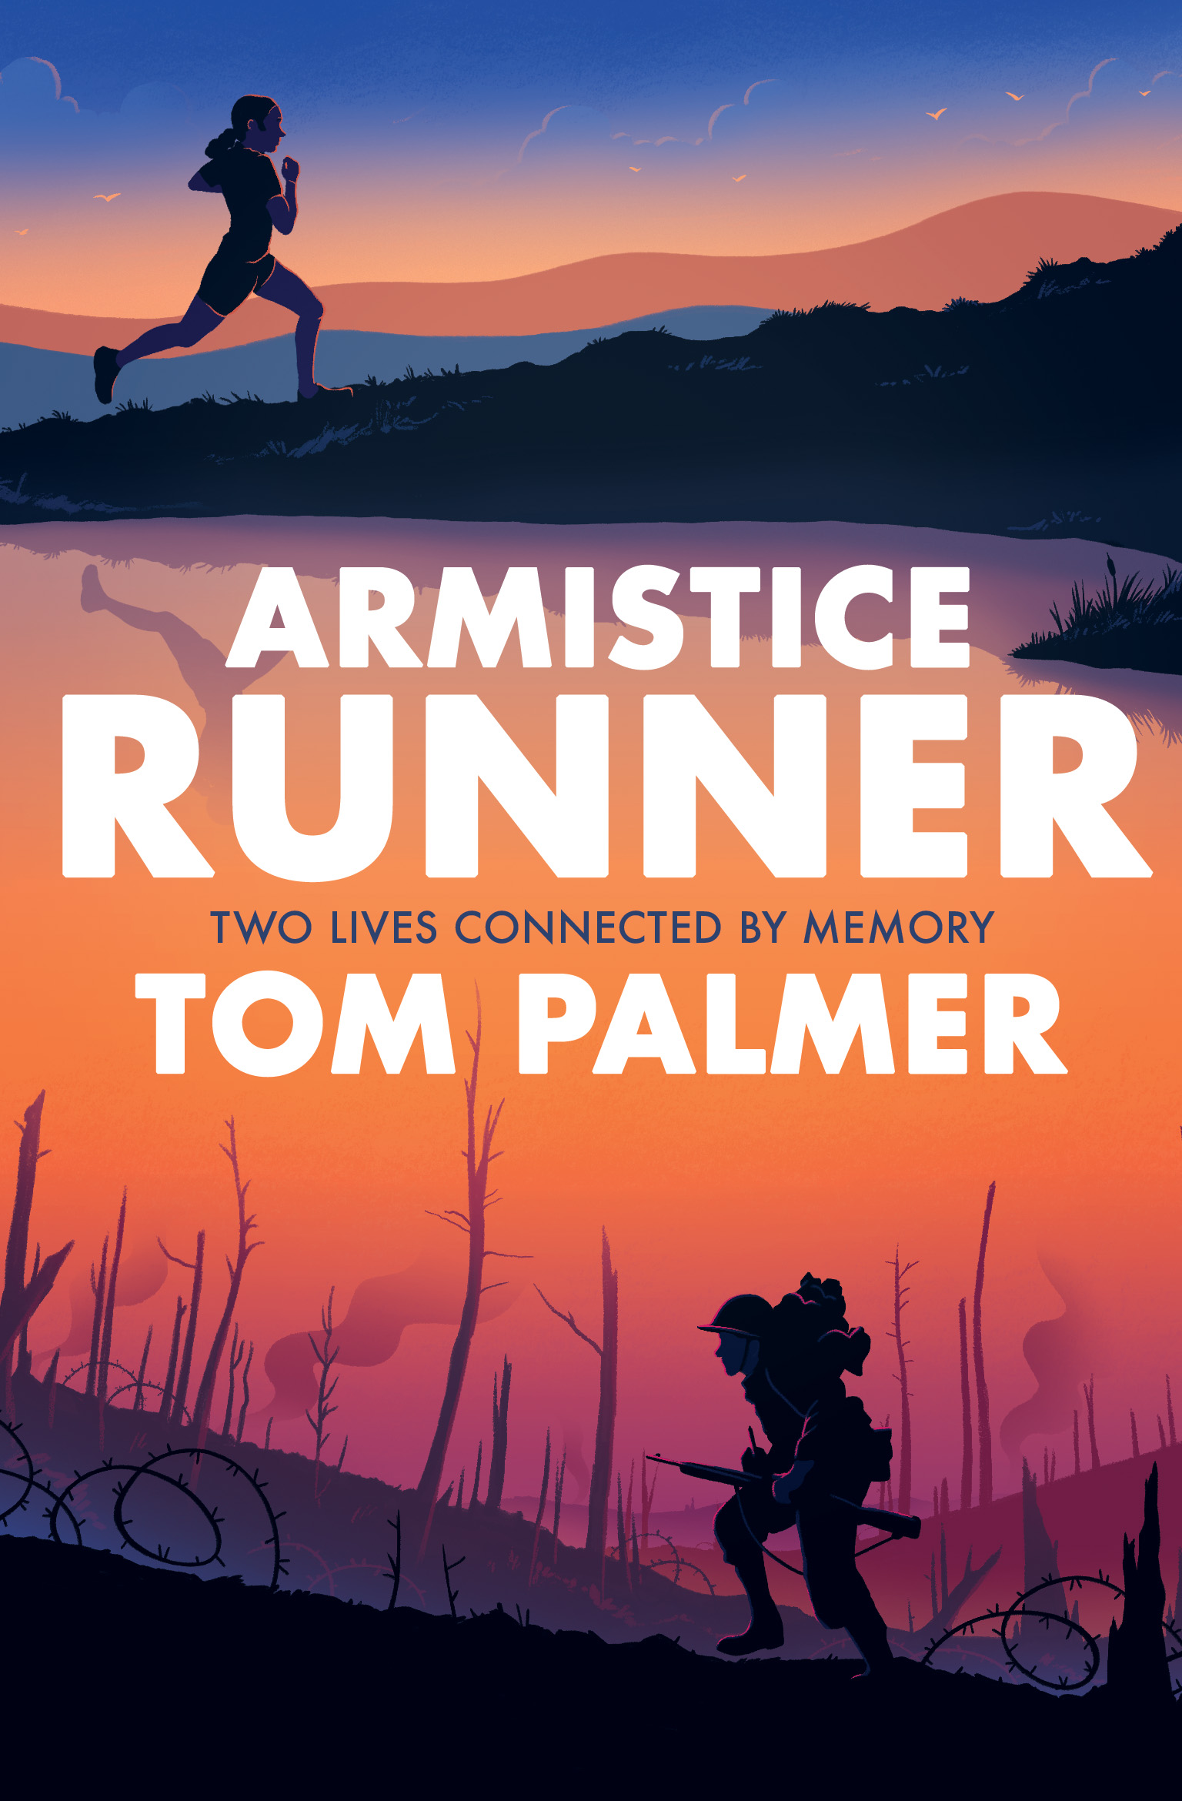
Armistice Runner by Tom Palmer
‘Powerfully poignant, this is a book not to be missed ... If there is one WWI story you read this year to commemorate the centenary, let it be this one!’
Scott Evans, The Reader Teacher & #PrimarySchoolBookClub

Slide 2
Who is Tom Palmer?
Tom Palmer is the author of 40 children’s books including the Football Academy, Foul Play, Rugby Academy, Wings and the Defenders series.
Foul Play was shortlisted for the Blue Peter Book of the Year award.

Slide 3
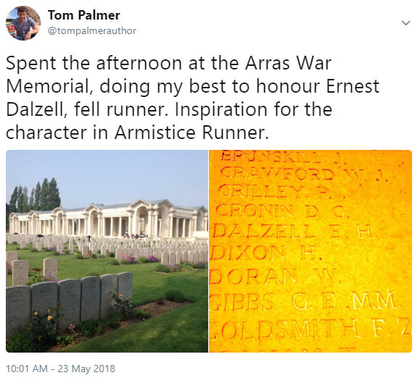
What is Armistice Runner about?
Armistice Runner is about a thirteen-year-old cross country/fell runner called Lily and her great, great grandfather, who was a champion fell runner before he became a trench runner during the last weeks of the First World War.

Slide 4
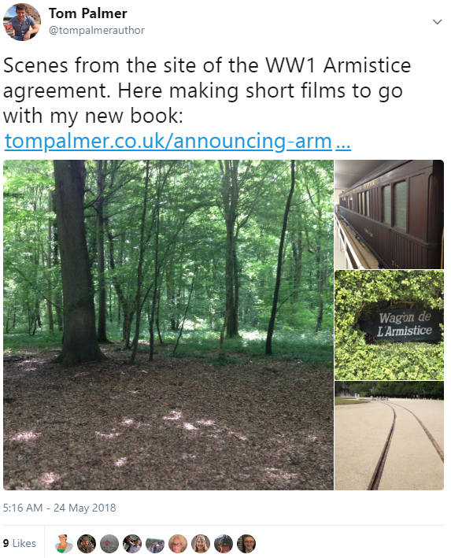
Interview with Tom Palmer about writing Armistice Runner
Why did you write about the first World War?
Tom : While researching Over the Line I became fascinated with the Armistice and how hundreds of thousands of men could collectively stop fighting at eleven a.m. after all they had been through. I read that there was no time to lay down communication wires, the allies had been advancing so quickly on the Germans. Runners were used to pass the news on.
Knowing that many cross-country and fell runners went to fight in the First World War, the story started there.

Slide 5
From Armistice Runner by Tom Palmer, page 158
“Identify yourself.”
It was a tired shout. But I knew to stick to protocol.
I stopped. Hands up. Then called back, “Private Darby, Border Regiment. With a message from Captain Whitaker.”
A tin hat appeared with a gaunt grey face beneath it.
“Get down, man,” the voice was louder now.
“You’re in their range of fire.”
I scrambled down on my backside to see six men in the bunker, four of them with their heads or their arms bandaged up. One was unconscious, a messy wound on his leg exposed to the air. A pile of rifles dry on sacking between them. Then the smell reached me. The disgusting smell of the man’s wound. It made me want to throw up. I could smell his flesh dying on his bones.

Slide 6
Five sets of eyes were on me. A wildness about them all.
I took a breath. “Captain Whitaker asks me to inform you that the ceasefire begins at 1100 hours this morning.”
Silence.
Five faces looked at me like I was a fool. Then one man stepped forward. I saw from his badge that he was a corporal. He looked at me blankly, a hint of a smile on his mud‑ and blood‑crusted face.
“Ceasefire, Corporal,” I repeated. “The Armistice was agreed this morning. There will be stretcher‑bearers and supplies with you by midday. Your orders are to stay put.”
I don’t know what sort of reaction I expected from these men who were all set to fling themselves at death.
Maybe cheers and laughter? Did I expect that?

Slide 7
Instead, they turned to each other, and to me, and shared silent grim handshakes. Then one of them fell back against the side of the crater and sobbed.
The Corporal put his filthy hand on the man’s shoulder and stared out across the mud.
I was about to head back to confirm to Captain Whitaker that I had reached the men – and to update
him on their condition – when there was the whoosh of a shell coming over. It hit the open land I’d come across.
We watched the earth jump, then heard the thud.
“Emptying their guns,” the Corporal mused.
“You be careful out there, son.”
“I will, sir,” I said.
Find out more about Armistice Runner here: http://tompalmer.co.uk/armistice-runner/

