Slide 1
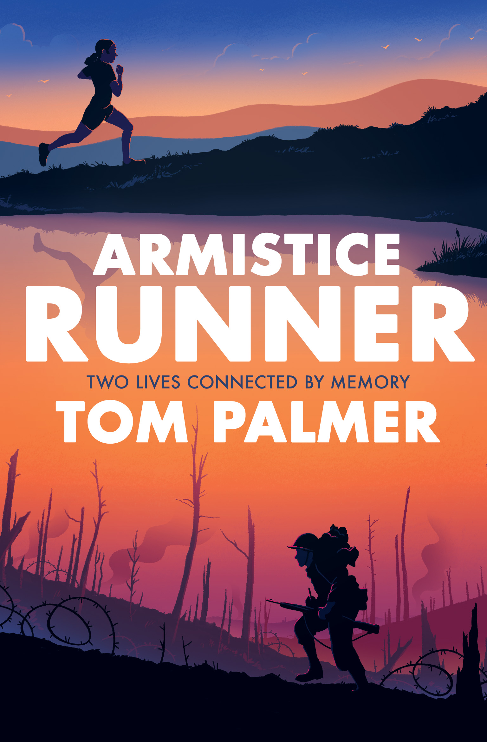
Armistice Runner by Tom Palmer
‘Powerfully poignant, this is a book not to be missed ... If there is one WWI story you read this year to commemorate the centenary, let it be this one!’
Scott Evans, The Reader Teacher & #PrimarySchoolBookClub

Slide 2
Who is Tom Palmer?
Tom Palmer is the author of 40 children’s books including the Football Academy, Foul Play, Rugby Academy, Wings and the Defenders series.
Foul Play was shortlisted for the Blue Peter Book of the Year award.

Slide 3
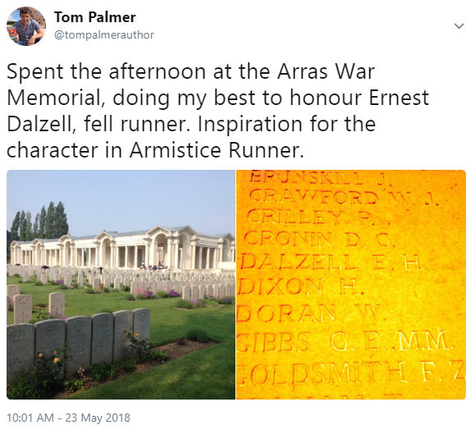
What is Armistice Runner about?
Armistice Runner is about a thirteen-year-old cross country/fell runner called Lily and her great, great grandfather, who was a champion fell runner before he became a trench runner during the last weeks of the First World War.

Slide 4
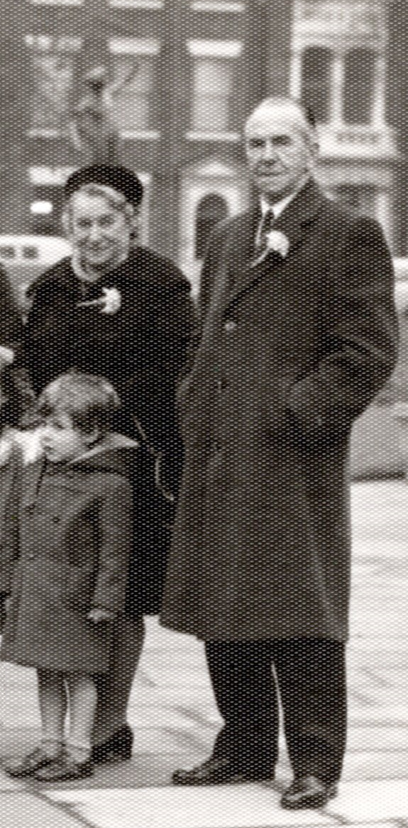
Interview with Tom Palmer about writing Armistice Runner
Why did you write about dementia?
Tom : Today’s grandparents are often portrayed in books as retired, cosy and very much hands-on with their grandchildren.
Sadly, many more families today are coping with the heartbreaking affect dementia has on their older loved ones. I have witnessed this in my own family. In Armistice Runner, I tried to capture the impact this has through Lily’s warm relationship with her ailing gran.
Me and my grandparents

Slide 5
From Armistice Runner by Tom Palmer, Chapter 3
As soon as she walked into her grandparents’ house, Lily understood. Things had changed.
There were two bin bags in the hall, full of rubbish and tied at the top. The house smelled
funny, not like its usual comfortable smell of Gran’s home‑cooked dinners or furniture polished until it gleamed.
Granddad had his arms open wide in welcome, but his eyes looked weary to Lily. His skin was grey and crumpled. Lily felt pain rising from her stomach to her chest. She clutched the present of a wrapped red scarf that she’d bought for her gran tighter in front of her.
“What’s that weird smell?” Tim asked.
“I’ve let the place go, Timmy.” Granddad tried to smile. “Need to concentrate on your gran. I keep the front room, kitchen and bedroom nice. The rest will have to go to the dogs.”

Slide 6
“What have you done to Meg and Gus?” Tim asked.
“Tim,” Mum rebuked.
“It’s OK.” Granddad sighed. “Tim can ask what he wants. There’s no point avoiding the truth.”
Granddad looked at Lily as he replied in a softer voice. “The dogs live in the back garden now. In the shed. Keeps them out of our way.”
The dogs lived outside! Lily had to stop herself gasping. She couldn’t believe it. All the time she’d been growing up, Meg and Gus had been in the house. She loved them and they loved her. They felt almost like cousins to her, rather than animals. But now they were outside. In the cold.
“Come on in,” Granddad said.

Slide 7
Gran was in the front room. There was a fire burning in the hearth, a neat stack of tinder and logs next to it, and a painting of hills on the wall above the fireplace. Lily smiled. Granddad was right.
This room felt good. This room hadn’t changed.
But Gran had. She looked smaller somehow. Lily hesitated for a half‑second before going to give her a big hug. Tim stayed by the door and put his hand into his mum’s.
They sat down in a circle of chairs and sofas.
Dad tried to start a conversation with his mum.
But she seemed to be half dreaming, miles away.
After a few attempts, Dad stood up, rubbed his face and left the room
Find out more about Armistice Runner here: http://tompalmer.co.uk/armistice-runner/

