Slide 1
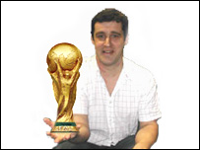
Dead Ball by Tom Palmer
Researching fiction set in Russia to link to the 2018 men’s football World Cup

Slide 2
Who is Tom Palmer?
Tom Palmer is the author of 40 children’s books including the Football Academy, Foul Play, Rugby Academy, Wings and Defenders series.
Foul Play was shortlisted for the Blue Peter Book of the Year award.

Slide 3
What are the Foul Play books about?
The heroes in Foul Play are a teenage wannabe detective called Danny Harte and his friend Charlotte.
Danny & Charlotte take on a dodgy football chairman and burglars in Foul Play, then a Russian billionaire in Dead Ball. In Off Side they take on a corrupt football agent and in Killer Pass, Danny tackles a burglar of footballers’ houses. In the final book in the series, Own Goal, Danny heads to Italy to tackle a worldwide football scam.
Danny is sometimes helped by journalist Anton Holt who he met whilst on work experience at the local newspaper.

Slide 4
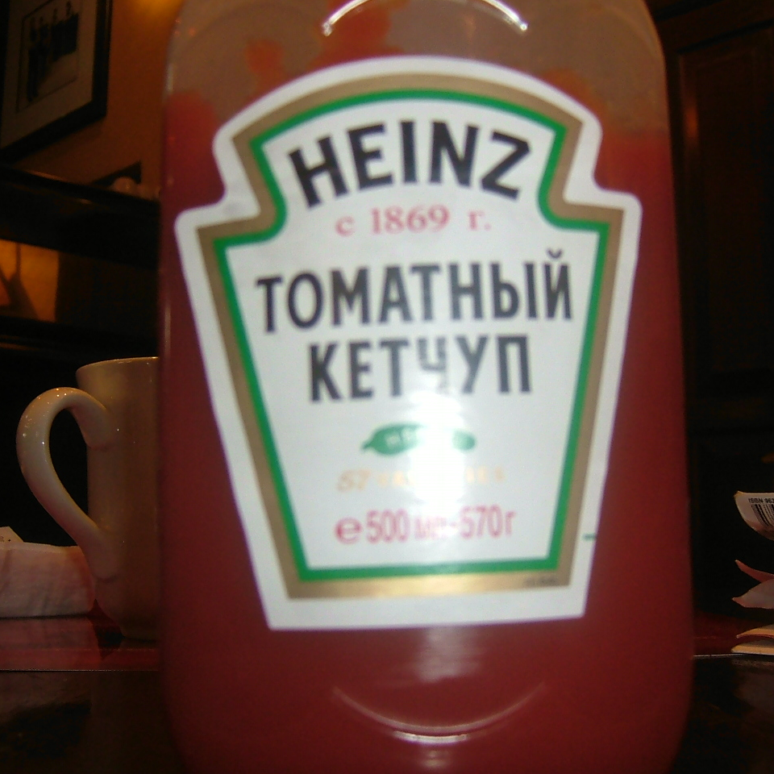
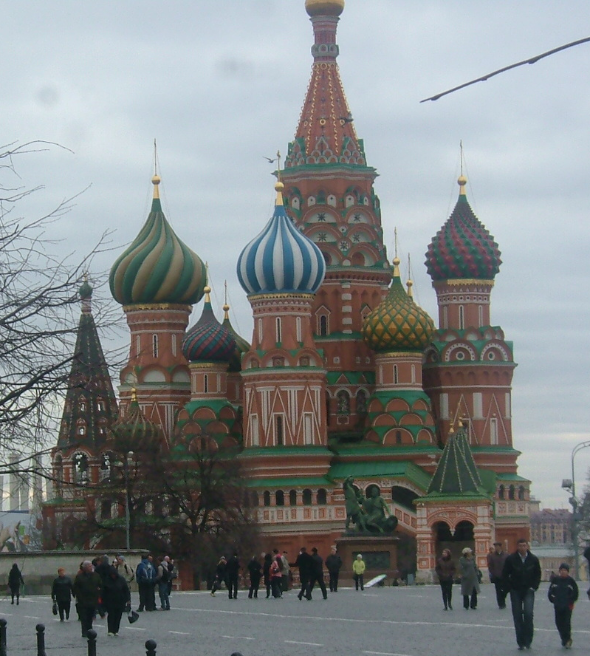
Anton Holt interviews Tom Palmer about writing Dead Ball
ANTON : Did you have to go to Russia to research Dead Ball?
TOM : I did. Twice. The first time I got a tour of the Luzhiniki Stadium, where Man U won the 2008 Champions League final against Chelsea. I wanted to see the press room and the corridors under the stands, so I could get the book right. They showed me everything.
ANTON : What about the second time?
TOM : The second time I saw a very rich man and his private army in a hotel bar. It was amazing to observe how they operated. Talking into microphones up their sleeves. All sitting on different tables, as if we didn’t know they were working as a unit. And the best bit… they were all drinking carrot juice.
ANTON : And how did that help the book?
TOM : It made it more realistic, I hope. I could never have imagined how a private army works. Lots of rich people in Russia have them. Also, I could describe the streets Danny walked on, and get a feel of a very different country to the UK.
Russian Tomato Ketchup
Tom Palmer outside the Luzhniki stadium
St Basil’s Cathedral

Slide 5
From Dead Ball by Tom Palmer, page 152
Danny decided to be brave. He was on his own in a city where barely anyone spoke English. He could have sat in his room. Waited all day. But there was something he really wanted to see in Moscow. Lenin's tomb.
He ordered a sandwich from room service and then went out into the city. He didn't want to see Lenin's tomb because he was a big fan of Russian history. He knew Lenin had been the first leader of Russia after it'd had its revolution. But that was about it.
Danny set off. The hotel was quite close to Red Square. According to the map he had to walk over the river, past a large cathedral with golden domes, take a right along the river and he'd be there.
Coming along and then across the river had been a struggle. The roads were so busy it'd been hard to find a place to cross. But Danny made it eventually.

Slide 6
Danny had read about Lenin's tomb in the guidebook. That you could go in and see his body. His actual dead body. A body that had been dead for eighty-five years. The body was in a building called a mausoleum. Something about that appealed to Danny.
It was horrible. Really horrible. But he couldn't resist. The guidebook had said that you could see his face and that his ears were all withered and tiny. Also, that loads of parts of his body had been replaced with wax and that some people thought Lenin was pretty much all wax now. Gross.
Red Square was still enormous. A huge ring of concrete boards surrounded the mausoleum.
Groups of people gawped at the cathedral, the mausoleum, the Kremlin. The walls that went along one side of the square were big - and the square itself so big - that Danny felt tiny. There was something about the scale of the place that was wrong. It was like the people were being made to feel that small.

Slide 7
The mausoleum was a small red building that would have looked quite big if it had not been dwarfed by the walls of the Kremlin. It had the letters Ленин across it. Several people were having their photographs taken, grinning into the cameras with the building holding their dead former leader inside. Including young children.
Danny frowned. The place gave him the creeps.
But he still wanted to see the body. He walked towards the entrance. There were two soldiers stood staring blankly out across the square. He thought about asking them if he could go in, but neither would meet his eyes. He was getting nowhere. And beginning to lose his nerve.
And that was when he saw Matt McGee, the England goalkeeper, walk straight in front of him. Less than a hundred metres away across the front of the mausoleum.
Find out more about Dead Ball here: http://tompalmer.co.uk/foul-play/dead-ball/

